Slide 1
"Don't Call it iteracy!: Creating impact through reading, writing, speaking and listening
Geoff Barton
teachingleaders: November 2, 2009

Slide 2
"Don't Call it iteracy!: Creating impact through reading, writing, speaking and listening
Download this presentation at www.geoffbarton.co.uk

Slide 3
Today:
Why literacy matters
Which bits matter
Making it happen … consistently

Slide 4
Today:
Why?
What?
How?

Slide 5
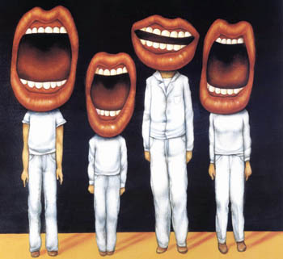
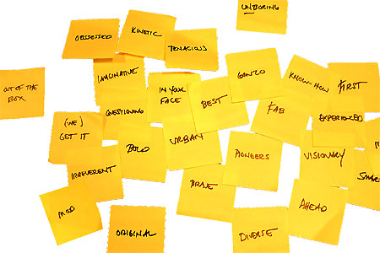
Approach:

Slide 6
WHY?

Slide 7
Health Check

Slide 9
Michael Barber

Slide 10
Literacy standards in England
1945
1997

Slide 11
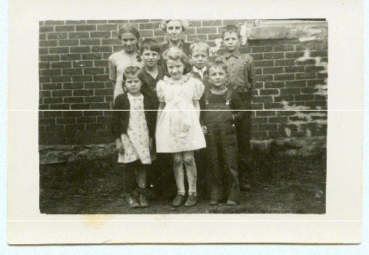

Slide 12
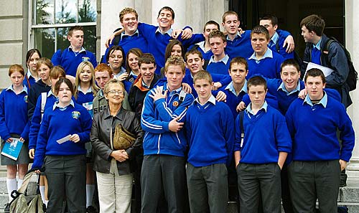

Slide 14
Beacon Schools
Training Schools
Coasting Schools
Super Heads
Consultant Heads
Executive Heads
Schools are becoming immune to school improvement
London Challenge
National Challenge
National Strategies
Leading Edge
Consultants
School improvement partners
Gaining Ground
Leading Light Schools
Trust Schools

Slide 15
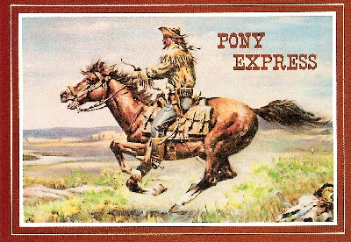

Slide 16
3 Provocations:
1
We haven’t ‘done’ literacy

Slide 17
3 Provocations:
2
Every teacher in English is a teacher of English
George Sampson, 1922

Slide 18
3 Provocations:
3
It’s not about grammar:
it’s about teaching & learning

Slide 19
The Literacy Club

Slide 20
Language oddities

Slide 21
DOGS MUST BE CARRIED ON THE ESCALATOR

Slide 22
Please don't smoke and live a more healthy life
PSHE Poster

Slide 23
Sign at Suffolk hospital:
Criminals operate in this area

Slide 24
ICI FIBRES

Slide 25
Churchdown parish magazine:
‘Would the congregation please note that the bowl at the back of the church labelled “for the sick” is for monetary donations only’

Slide 26
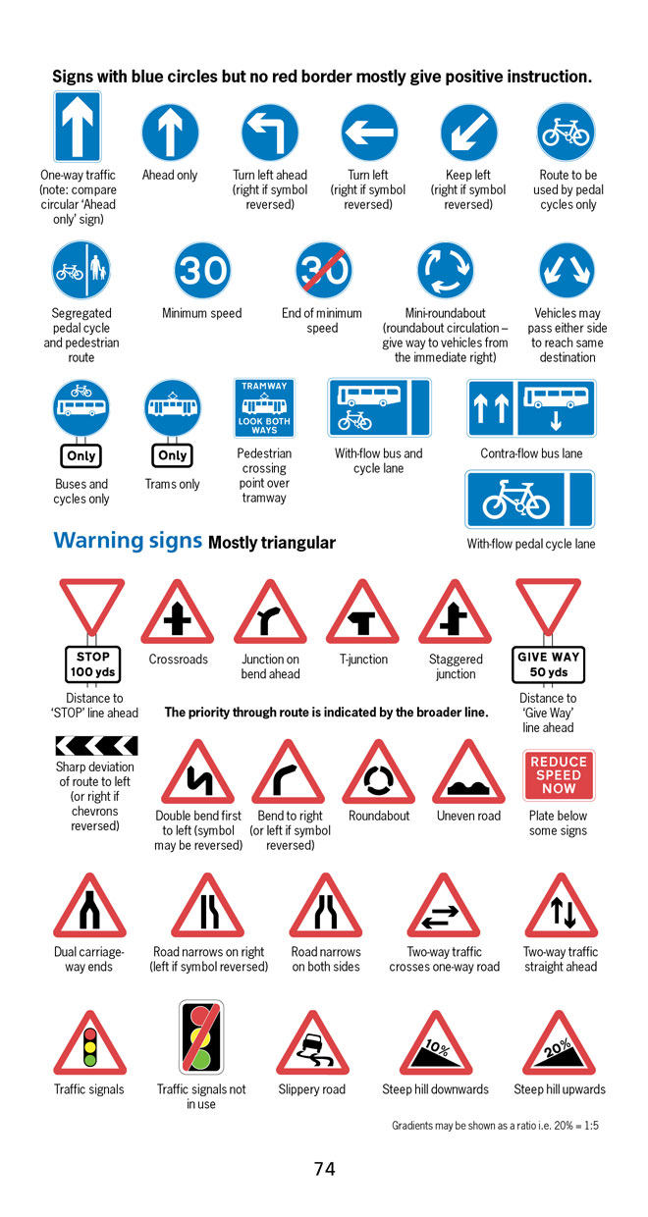
BBC NEWS ONLINE:
More than half of British motorists cannot interpret road signs properly, according to a survey by the Royal Automobile Club.
The survey of 500 motorists highlighted just how many people are still grappling with it.

Slide 27
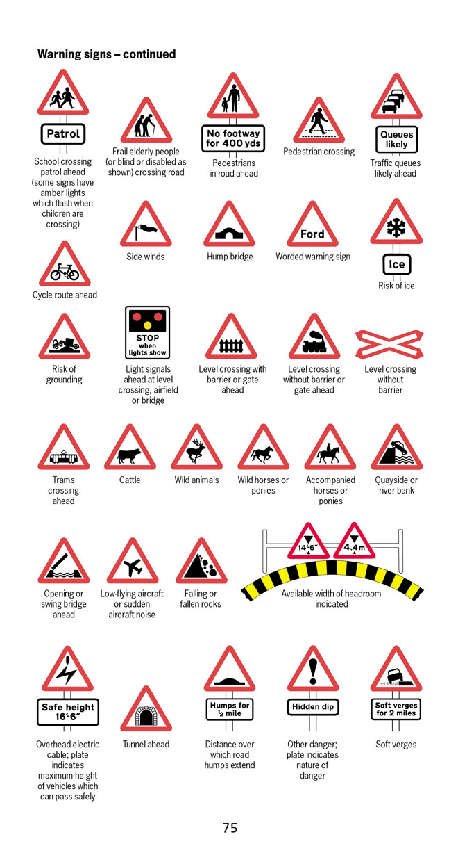
According to the survey, three in five motorists thought a "be aware of cattle" warning sign indicated …
an area infected with foot-and-mouth disease.

Slide 28
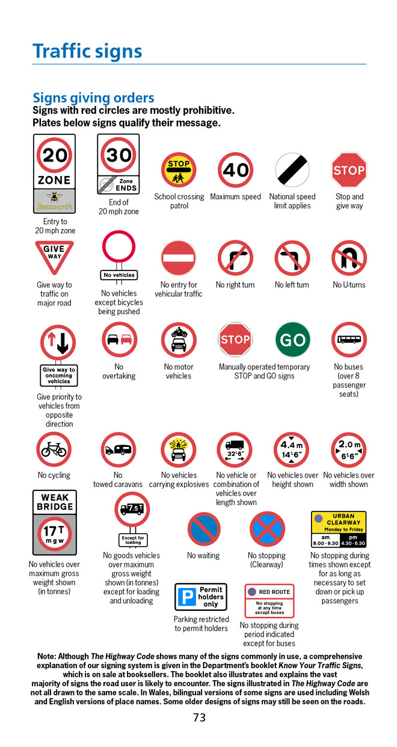
No motor vehicles
Beware of fast motorbikes

Slide 29
October 2005: Key findings
Schools do not always seem to understand the importance of pupils’ talk in developing both reading and writing.

Slide 30
October 2005: Key findings
Myhill and Fisher: ‘spoken language forms a constraint, a ceiling not only on the ability to comprehend but also on the ability to write, beyond which literacy cannot progress’.

Slide 31
October 2005: Key findings
Pupils do not improve writing solely by doing more of it; good quality writing benefits from focused discussion that gives pupils a chance to talk through ideas before writing and to respond to friends’ suggestions.

Slide 32
October 2005: Key findings
NFER 2003: children’s enjoyment of reading had declined significantly in recent years
A Nestlé/MORI report : ‘underclass’ of non-readers, plus cycles of non-reading ‘where teenagers from families where parents are not readers will almost always be less likely to be enthusiastic readers themselves’.

Slide 33
October 2005: Key findings
2009
Pointlessness of many writing tasks
Futility of silent reading
Limited impact of ICT

Slide 34
LITERACY
IMPACT
IMPACT

Slide 35
WHAT?

Slide 36
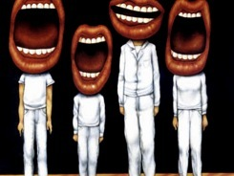
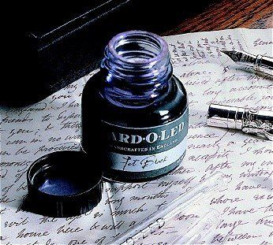

Slide 37
Understand the significance of exploratory talk
Model good talk – eg connectives
Re-think questioning: why & how?
Re-think hands-up
Get conversations into the school culture

Slide 38
Teach reading – scanning, skimming, analysis
Read aloud and display
Teach key vocabulary
Demystify spelling
Teach research, not FOFO

Slide 39
SKIMMING

Slide 40
The climate of the Earth is always changing. In the past it has altered as a result of natural causes. Nowadays, however, the term climate change is generally used when referring to changes in our climate which have been identified since the early part of the 1900’s. The changes we've seen over recent years and those which are predicted over the next 80 years are thought to be mainly as a result of human behaviour rather than due to natural changes in the atmosphere.

Slide 41
The best treatment for mouth ulcers. Gargle with salt water. You should find that it works a treat. Salt is cheap and easy to get hold of and we all have it at home, so no need to splash out and spend lots of money on expensive mouth ulcer creams.

Slide 42
Urquhart castle is probably one of the most picturesquely situated castles in the Scottish Highlands. Located 16 miles south-west of Inverness, the castle, one of the largest in Scotland, overlooks much of Loch Ness. Visitors come to stroll through the ruins of the 13th-century castle because Urquhart has earned the reputation of being one of the best spots for sighting Loch Ness’s most famous inhabitant.

Slide 43
SCANNING

Slide 44
Where did the first cell phones begin?
Name 2 other features that started to be included in phones
Why are cell phones especially useful in some countries?

Slide 45
Where begin?
Two features?
Some countries?
Cellular telephones
The first cellular telephone system began operation in Tokyo in 1979, and the first U.S. system began operation in 1983 in Chicago. A camera phone is a cellular phone that also has picture taking capabilities. Some camera phones have the capability to send these photos to another cellular phone or computer. Advances in digital technology and microelectronics has led to the inclusion of unrelated applications in cellular telephones, such as alarm clocks, calculators, Internet browsers, and voice memos for recording short verbal reminders, while at the same time making such telephones vulnerable to certain software viruses. In many countries with inadequate wire-based telephone networks, cellular telephone systems have provided a means of more quickly establishing a national telecommunications network.

Slide 46
Research skills, not FOFO

Slide 47
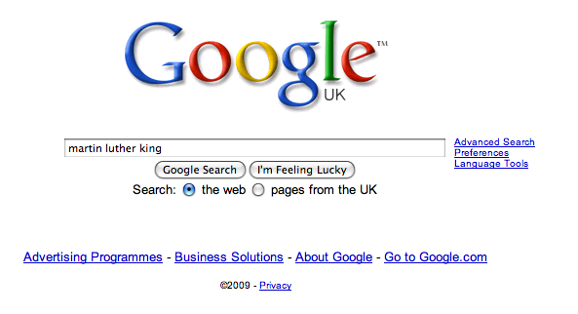

Slide 55
Teach reading – scanning, skimming, analysis
Read aloud and display
Teach key vocabulary
Demystify spelling
Teach research, not FOFO

Slide 56
Demonstrate writing
Teach composition & conventions
Allow oral rehearsal
Short & long sentences
Connectives

Slide 57
Know your connectives
Adding: and, also, as well as, moreover, too
Cause & effect: because, so, therefore, thus, consequently
Sequencing: next, then, first, finally, meanwhile, before, after
Qualifying: however, although, unless, except, if, as long as, apart from, yet
Emphasising: above all, in particular, especially, significantly, indeed, notably
Illustrating: for example, such as, for instance, as revealed by, in the case of
Comparing: equally, in the same way, similarly, likewise, as with, like
Contrasting: whereas, instead of, alternatively, otherwise, unlike, on the other hand

Slide 58
Demonstrate writing
Teach composition & conventions
Allow oral rehearsal
Short & long sentences
Connectives

Slide 59
HOW?

Slide 60
Consistency = Equal Opps
Would I be happy …?
Tin opener evaluation of impact
Re-think tutor time
This isn’t literacy: it’s what good teachers do

Slide 61
LITERACY
IMPACT
Over to you …

Slide 62
"Don't Call it iteracy!: Creating impact through reading, writing, speaking and listening
Download this presentation at www.geoffbarton.co.uk

