Slide 1
Re-Booting English
Geoff Barton
Download free at www.geoffbarton.co.uk

Slide 4
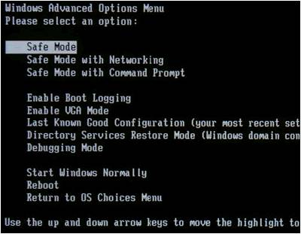

Slide 7
Verb 1. reboot - cause to load (an operating system) and start the initial processes;
See: boot, bring up, resuscitate, revive
Ref: “The doctors revived the comatose man”
Princeton Online Dictionary

Slide 9
ENGLISH
LITERACY

Slide 10
ENGLISH
LITERACY

Slide 13
English Now
Literacy Now
Five case studies
Where next …?
Beyond merely D to C conversion

Slide 14
Subject Reviews 2005 & 2009
“English at the Crossroads”

Slide 15
English 2005:
Myhill and Fisher: ‘spoken language forms a constraint, a ceiling not only on the ability to comprehend but also on the ability to write, beyond which literacy cannot progress’.
1
Although the reading skills of 10 year old pupils in England compared well with those of pupils in other countries, they read less frequently for pleasure and were less interested in reading than those elsewhere.
2
3
Pupils’ writing does not improve solely by doing more of it.

Slide 16
English 2009:
All the English departments visited had schemes of work for KS3 but, since they rarely showed them to the students, students could not see how individual elements linked together and supported each other.
To many students, the KS3 programme seemed a random sequence of activities …
1

Slide 17
English 2009:
Some schools persevered with ‘library lessons’ where the students read silently. These sessions rarely included time to discuss or promote books and other written material and therefore did not help to develop a reading community within the school.
2

Slide 18
English 2009:
Many of the lessons seen during the survey showed there was a clear need to reinvigorate the teaching of writing. Students were not motivated by the writing tasks they were given and saw no real purpose to them.
3

Slide 19
English 2009:
Ofsted’s previous report on English found that schools put too little emphasis on developing speaking and listening. Since then, the teaching of speaking and listening has improved.
4

Slide 20
English 2009:
The last English report identified a wide gap between the best practice and the rest in using ICT. This gap remains; indeed, some of the evidence suggests that it has widened.
5

Slide 21
Whole-school literacy:
Every teacher in English …
Teach reading, not FOFO …
Demystify spelling …
Model writing …
Emphasise quality talk …

Slide 22
CASE STUDIES

Slide 23
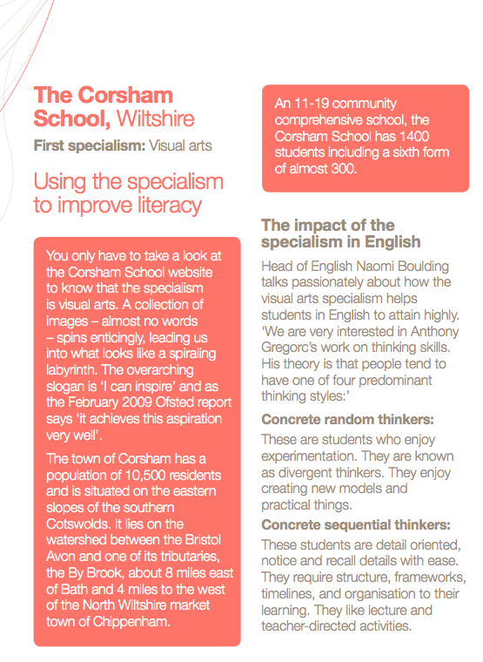
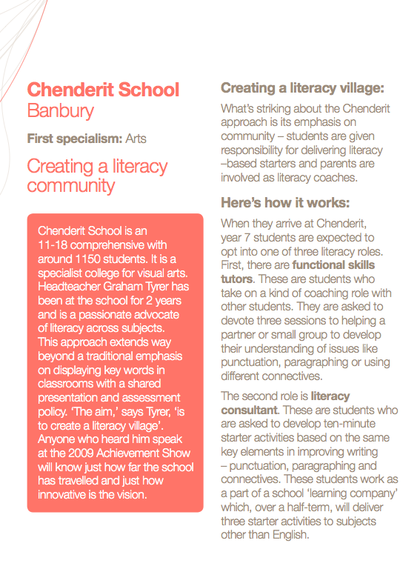
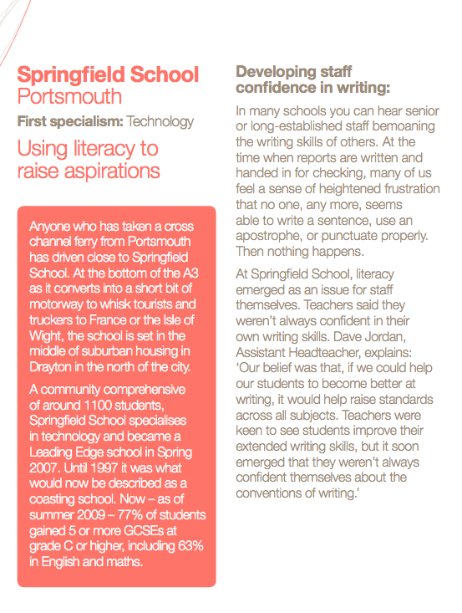

Slide 24
Students as functional skills tutors and literacy consultants
Starters on writing across subjects
Parents as reading tutors

Slide 25
70% EAL;
2008: 5GCSE+EM=71%
Interventions Swedish style
Literacy buy-in across the school

Slide 26
Gregorc’s work on concrete and abstract thinking
The ‘Making Room’
Impact on students’ reading and writing

Slide 27
Teach extended writing – initially in Art and Drama
Tackle teacher confidence in writing
Create literacy ‘events’

Slide 28
Targeted intervention by HLTA
Single sex ability groups from Year 9
Teachers matched to groups
Early entry and S&L days

Slide 31
Re-Booting English
Geoff Barton
Download free at www.geoffbarton.co.uk

