Slide 1
Reading Demo

Slide 2
SKIMMING

Slide 3
Proud mum in a million Natalie Brown hugged her beautiful baby daughter Casey yesterday and said: “She’s my double miracle.”

Slide 4
The climate of the Earth is always changing. In the past it has altered as a result of natural causes. Nowadays, however, the term climate change is generally used when referring to changes in our climate which have been identified since the early part of the 1900's . The changes we've seen over recent years and those which are predicted over the next 80 years are thought to be mainly as a result of human behaviour rather than due to natural changes in the atmosphere.

Slide 5
The best treatment for mouth ulcers. Gargle with salt water. You should find that it works a treat. Salt is cheap and easy to get hold of and we all have it at home, so no need to splash out and spend lots of money on expensive mouth ulcer creams.

Slide 6
Urquhart castle is probably one of the most picturesquely situated castles in the Scottish Highlands. Located 16 miles south-west of Inverness, the castle, one of the largest in Scotland, overlooks much of Loch Ness. Visitors come to stroll through the ruins of the 13th-century castle because Urquhart has earned the reputation of being one of the best spots for sighting Loch Ness’s most famous inhabitant.

Slide 7
SCANNING

Slide 8
Where did the first cell phones begin?
Name 2 other features that started to be included in phones
Why are cell phones especially useful in some countries?

Slide 9
1 -Where begin?
2 - Two features?
3 - Some countries?
Cellular telephones
The first cellular telephone system began operation in Tokyo in 1979, and the first U.S. system began operation in 1983 in Chicago. A camera phone is a cellular phone that also has picture taking capabilities. Some camera phones have the capability to send these photos to another cellular phone or computer. Advances in digital technology and microelectronics has led to the inclusion of unrelated applications in cellular telephones, such as alarm clocks, calculators, Internet browsers, and voice memos for recording short verbal reminders, while at the same time making such telephones vulnerable to certain software viruses. In many countries with inadequate wire-based telephone networks, cellular telephone systems have provided a means of more quickly establishing a national telecommunications network.

Slide 10
- what was Mr B’s sister called? - where did she live? - where did Young Mr B live?
Scanning II:

Slide 11
Bad Memories
When he was a child, Mr Barton was very good looking and very popular with everyone. His second worst memory was when he was about six and he was lying down watching Thunderbirds. Suddenly his uncle’s big black labrador came and stood over him, pinning him to the floor. This left Mr B traumatised and explains his dislike of dogs, especially big ones with slobbery tongues. But this was probably a bit better than his worst memory which took place when he was eight. Mr B’s sister Jean had taken him to stay with her near London. She took him to London Zoo and other famous sites as a February half-term treat. It was the first time Young Mr B had stayed away from home and he was very home-sick. Finally, after 3 days, Mr B’s sister decided to give up and take him home to his parents in Stafford. She took him by train and sat him down in a packed carriage. Then she let young Mr B eat lots of chocolate. Just as the train was starting to approach the home town of Stafford, Mr B turned very pale. He was feeling very sick indeed. He knew he couldn’t make it in time to the toilet. There were too many people in the carriage. He whispered to his sister that he was going to be sick but, before he had finished his sentence, he had vomited everywhere, covering the table in lumpy chocolate-covered vomit. His sister didn’t know what to do and, feeling ashamed, pulled Young Mr B off the train leaving behind a smelly and gently steaming table of fresh vomit.

Slide 12
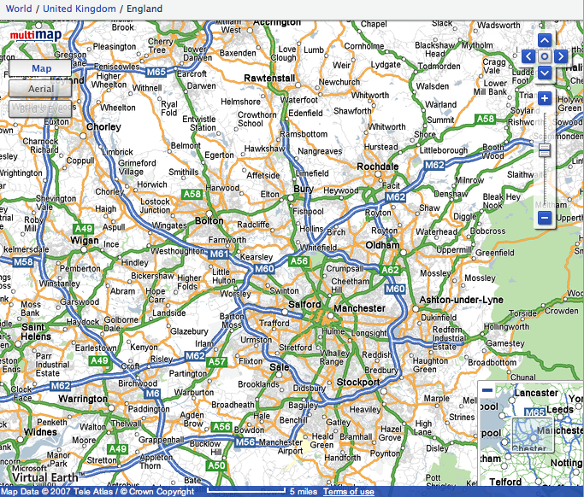

Slide 13
Get me from Whitworth (above Rochdale) to Manchester Airport (bottom centre)
Write down a village that is due west of Bolton
Write down a village that is due south of Sale
Name 4 villages on the A58
Write down 4 villages (not towns) that are within the M60 motorway
Find and then describe where these villages are (use words like just to the west of …):
a) Pemberton
b) Lumb
c) Dobcross

Slide 22
How would YOU start a biography of a famous writer?

Slide 23
The Life of Charles Dickens
Chapter 1
CHARLES DICKENS, the most popular novelist of the century, and one of the greatest humorists that England has produced, was born at Lanport, in Portsea, on Friday, the seventh of February, 1812.
His father, John Dickens, a clerk in the navy pay-office, was at this time stationed in the Portsmouth Dockyard. He had made acquaintance with the lady, Elizabeth Barrow, who became afterwards his wife, through her elder brother, Thomas Barrow, also engaged on the establishment at Somerset House, and she bore him in all a family of eight children, of whom two died in infancy. The eldest, Fanny (born 1810), was followed by Charles (entered in the baptismal register of Portsea as Charles John Huffham, though on the very rare occasions when he subscribed that name he wrote Huffam); by another son, named Alfred, who died in childhood; by Letitia (born 1816); by another daughter, Harriet, who died also in childhood; by Frederick (born 1820); by Alfred Lamert (born 1822); and by Augustus (born 1827).

Slide 24
DICKENS
CHARLES DICKENS was dead. He lay on a narrow green sofa – but there was room enough for him, so spare had he become – in the dining room of Gad’s Hill Place. He had died in the house which he had first seen as a small boy and which his father had pointed out to him as a suitable object of his ambitions; so great was his father’s hold upon his life that, forty years later, he had bought it. Now he had gone. It was customary to close the blinds and curtains, thus enshrouding the corpse in darkness before its last journey to the tomb; but in the dining room of Gad’s Hill the curtains were pulled apart and on this June day the bright sunshine streamed in, glittering on the large mirrors around the room. The family beside him knew how he enjoyed the light, how he needed the light; and they understood, too, that none of the conventional sombreness of the late Victorian period – the year was 1870 – had ever touched him.
All the lines and wrinkles which marked the passage of his life were new erased in the stillness of death. He was not old – he died in his fifty-eighth year – but there had been signs of premature ageing on a visage so marked and worn; he had acquired, it was said, a “sarcastic look”. But now all that was gone and his daughter, Katey, who watched him as he lay dead, noticed how there once more emerged upon his face “beauty and pathos”.

Slide 25
BUILDING TENSION
Brian Moore, Cold Heaven

Slide 26
1
The wooden seats of the little pedal boat were angled so that Marie looked up at the sky. There were no clouds. In the vastness above her a gull calligraphed its flight. Marie and Alex pedalled in unison, the revolving paddles making a slapping sound against the waves as the pedal boat treadmilled away from the beach, passing through ranks of bathers to move into the deeper, more solitary waters of the Baie des Anges. Marie slackened her efforts but Alex continued determinedly, steering the pedalo straight out into the Mediterranean.

Slide 27
2
‘Let’s not go too far,’ she said.
‘I want to get away from the crowd. I’m going to swim.’
It was like him to have some plan of his own, to translate idleness into activity even in these few days of vacation. She now noted his every fault. It was as though, having decided to leave him, she had withdrawn his credit. She looked back at the sweep of hotels along the Promenade des Anglais. Today was the day she had hoped to tell him. She had planned to announce it at breakfast and leave, first for New York, then on to Los Angeles to join Daniel. But at breakfast she lacked all courage. Now, with half the day gone, she decided to postpone it until tomorrow.

Slide 28
3
Far out from shore, the paddles stopped. The pedalo rocked on its twin pontoons as Alex eased himself up from his seat. He handed her his sunglasses. ‘This should do,’ he said and, rocking the boat even more, dived into the ultramarine waters. She watched him surface. He called out: ‘Just follow along, okay?’ He was not a good swimmer, but thrashed about in an energetic, erratic freestyle. Marie began to pedal again, her hand on the tiller, steering the little boat so that she followed close. Watching him, she knew he could not keep up this pace for long. She saw his flailing arms and for a moment thought of those arms hitting her. He had never hit her. He was not the sort of man who would hit you. He would be hurt, and cold, and possibly vindictive. But he was not violent.

Slide 29
4
She heard a motorboat, the sound becoming louder. She looked back but did not see a boat behind her. Then she looked to the right where Alex was swimming and saw a big boat with an outboard motor coming right at them, coming very fast.

Slide 30
5
Of course they see us, she thought, alarmed, and then as though she were watching a film, as though this were happening to someone else, she saw there was a man in the motorboat, a young man wearing a green shirt; he was not at the tiller, he was standing in the middle of the boat with his back to her and as she watched he bent down and picked up a child who had fallen on the floorboards. ‘Hey?’ she called. ‘Hey?’ for he must turn around, the motorboat was coming right at Alex, right at her. But the man in the boat did not hear. He carried the child across to the far side of the boat; the boat was only yards away now.

Slide 31
6
‘Alex,’ she called. ‘Alex, look out.’ But Alex flailed on and then the prow of the motorboat, slicing up water like a knife, hit Alex with a sickening thump, went over him and smashed into the pontoons of the little pedal boat, upending it, and she found herself in the water, going under, coming up. She looked and saw the motorboat churning off, the pedal boat hanging from its prow like a tangle of branches. She heard the motorboat engine cut to silence, then start up again as the boat veered around in a semicircle and came back to her. Alex?

Slide 32
7
She looked: saw his body near her just under the water. She swam toward him, breastroke, it was all she knew. He was floating face down, spread-eagle. She caught hold of his wrist and pulled him towards her. The motorboat came alongside, the man in the green shirt reaching down for her, but, ‘No, no,’ she called and tried to push Alex toward him. The man caught Alex by the hair of his head and pulled him up, she pushing, Alex falling back twice into the water, before the man, with a great effort, lifted him like a sack across the side of the boat, tugging and heaving until Alex disappeared into the boat. The man shouted, ‘Un instant, madame, un instant’ and reappeared, putting a little steel ladder over the side. She climbed up onto the motorboat as the man went out onto the prow to disentangle the wreckage of the pedalo.

Slide 33
8
A small child was sitting at the back of the boat, staring at Alex’s body, which lay face-down on the floorboards. She went to Alex and saw blood from a wound, a gash in the side of his head, blood matting his hair. He was breathing but unconscious. She lifted him and cradled him in her arms, his blood trickling onto her breasts. She saw the boat owner’s bare legs go past her as he went to the rear of the boat to restart the engine. The child began to bawl but the man leaned over, silenced it with an angry slap, the man turned to her, his face sick with fear. ‘Nous y serons dans un instant,’ he shouted, opening the motor to full throttle. She hugged Alex to her, a rivulet of blood dripping off her forearm onto the floorboards as the boat raced to the beach.

Slide 34
BUILDING TENSION
Brian Moore, Cold Heaven

Slide 35
Reading Demo

