Slide 1
The Yellowing of English
Geoff Barton
NAAE Conference
October 15, 2009
Download this presentation at www.geoffbarton.co.uk

Slide 4
1: Where we are and how we got here

Slide 5
2: What we need to fight for in English now

Slide 6
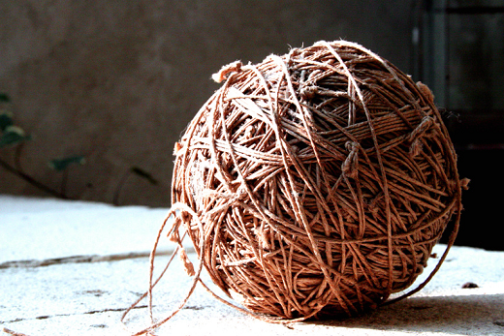

Slide 7
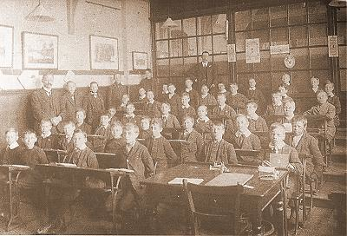

Slide 9
Margaret Mathieson,
“The Preachers of Culture”

Slide 10
Parse the italicised words:
“The lady protests too much, methinks”
“Sit thee down”
“I saw him taken”
Rewrite these sentences correctly:
“Louis was in some respects a good man, but being a bad ruler his subjects rebelled”
“Vainly endeavouring to suppress his emotion, the service was abruptly brought to an end”
Alfred S West, The Elements of English Grammar

Slide 11
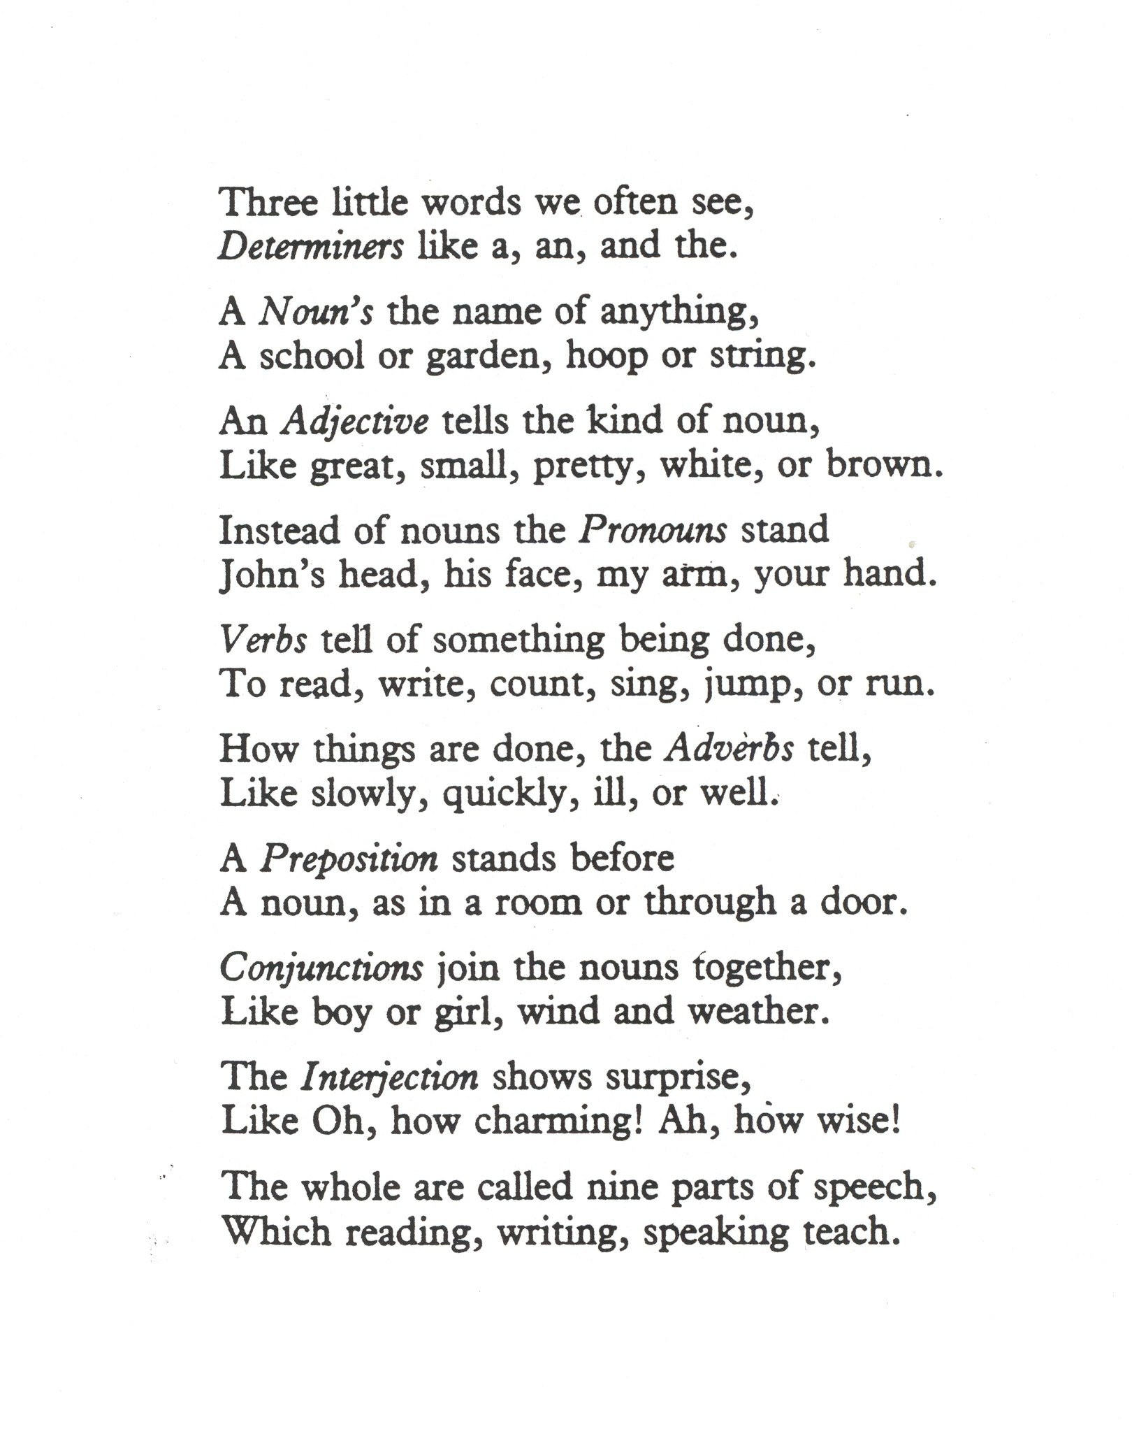

Slide 12
For each of the following write a sentence containing the word or clause indicated:
That used as a subordinating conjunction
That used as a relative pronoun
An adjective used in the comparative degree
A pronoun used as a direct object
An adverbial clause of concession
A noun clause in apposition
A collective noun
JMB O-level English Language, 1967

Slide 13
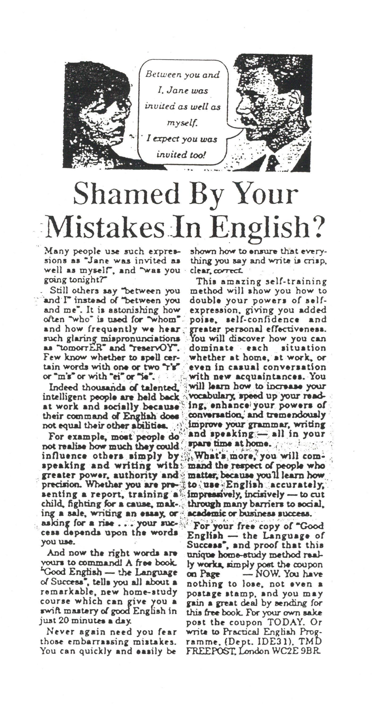

Slide 14
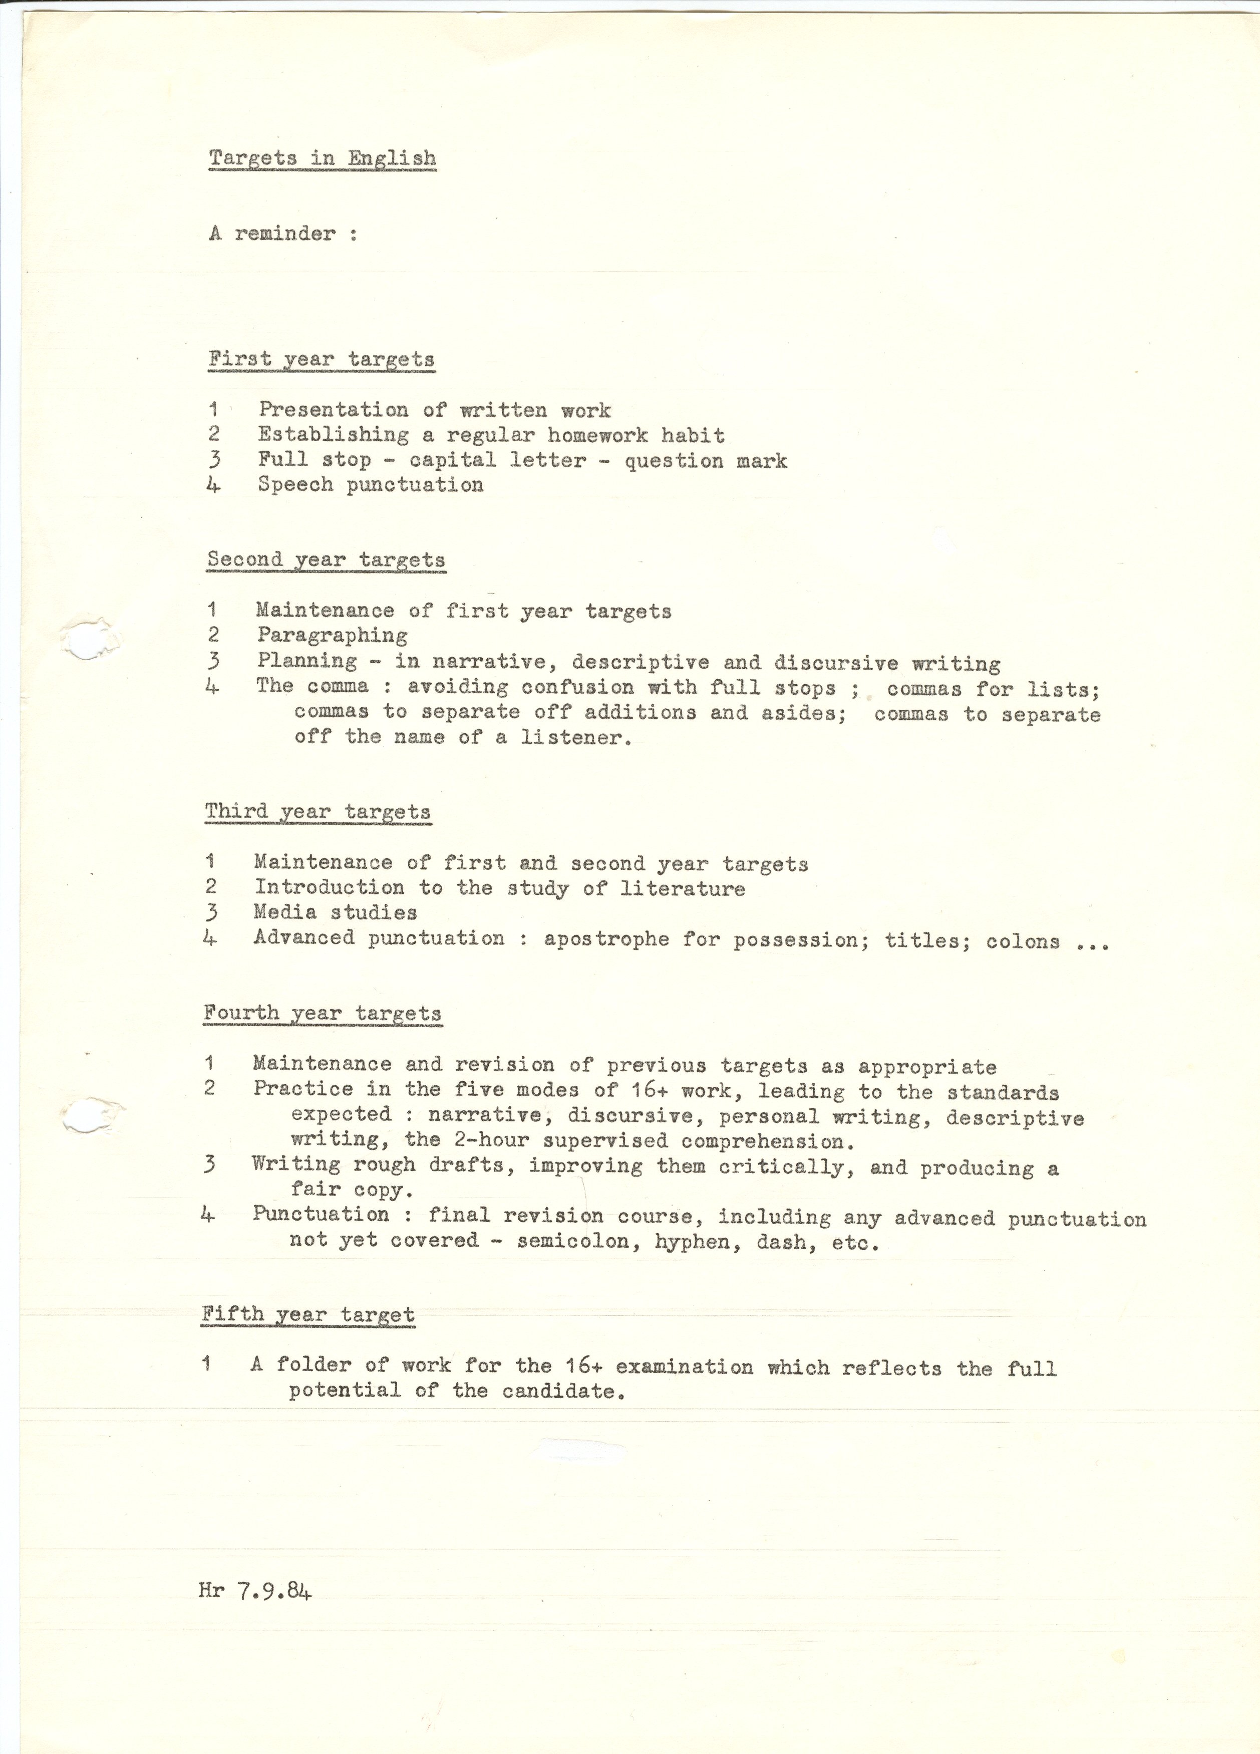

Slide 15
Autonomy
O-level / CSE
16+
NC
Coursework
GCSE
Framework
Performance tables
5A*C+EM
Disempowerment

Slide 18
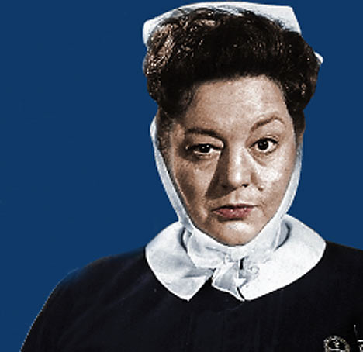

Slide 19
Michael Barber

Slide 20
Literacy standards in England
1945
1997

Slide 22
Beacon Schools
Training Schools
Coasting Schools
Super Heads
Consultant Heads
Executive Heads
Schools are becoming immune to school improvement
London Challenge
National Challenge
National Strategies
Leading Edge
Consultants
School improvement partners
Gaining Ground
Leading Light Schools
Trust Schools

Slide 23
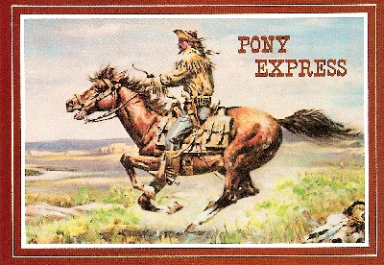

Slide 24
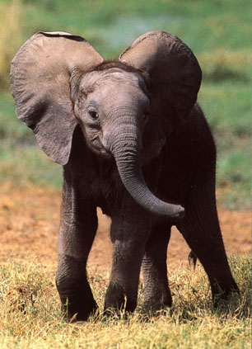
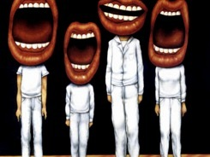
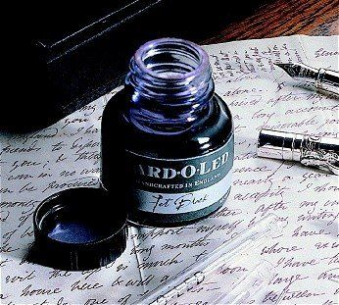

Slide 25
Key conventions
Demonstrate writing.
Link to speech
Teach composition
Importance of reading
Sentence variety
Connectives

Slide 26
Know your connectives
Adding: and, also, as well as, moreover, too
Cause & effect: because, so, therefore, thus, consequently
Sequencing: next, then, first, finally, meanwhile, before, after
Qualifying: however, although, unless, except, if, as long as, apart from, yet
Emphasising: above all, in particular, especially, significantly, indeed, notably
Illustrating: for example, such as, for instance, as revealed by, in the case of
Comparing: equally, in the same way, similarly, likewise, as with, like
Contrasting: whereas, instead of, alternatively, otherwise, unlike, on the other hand

Slide 27
Reading needs teaching: skimming, scanning, analysis
Read aloud.
Demystify spelling
Use DARTs: prediction, jumbled texts, pictures and graphs
Teach and display subject-specific vocabulary
Teach research skills, not FOFO
Presentation and framing can make texts more accessible

Slide 28
No hands up
Break tyranny of Q&A
Thinking time
Key words / connectives
Reflective groupings
Exploratory, not presentational talk
Get teachers watching teachers who manage S&L well

Slide 29
We need to make their lives easier
Regain philosophy
Consistency is an equal opportunities issue
Not just the C to D issue
Fight for time and resources
Be aware of the impact of the 5A*-C+EM agenda
What happens in the classroom matters most
Emphasise whole-school literacy

Slide 30
1: Where we are and how we got here

Slide 31
2: What we need to fight for in English now

Slide 32
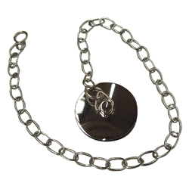

Slide 33
The new multi-media KS3 course by Geoff Barton & Mike Jones
Published by Pearson

Slide 34
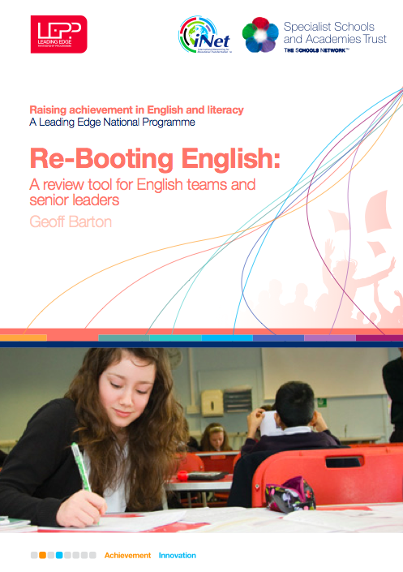

Slide 35
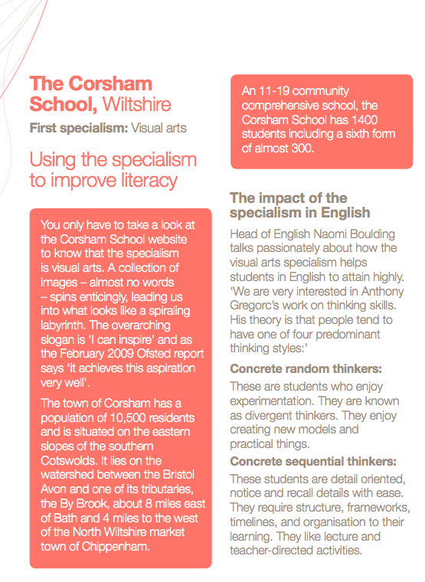
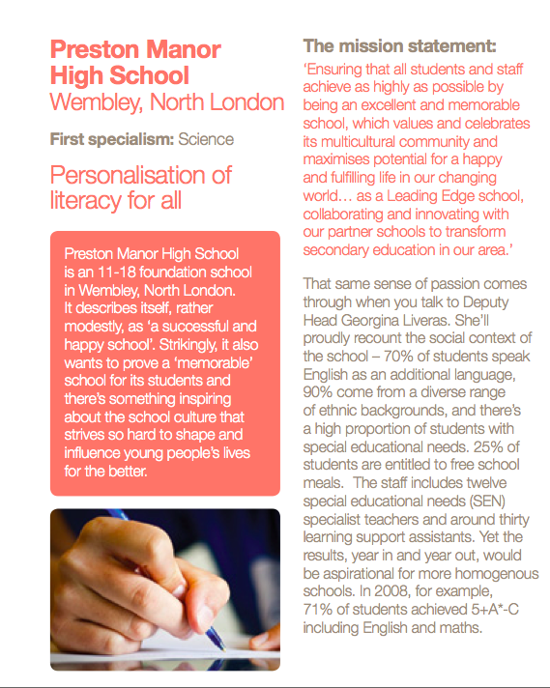
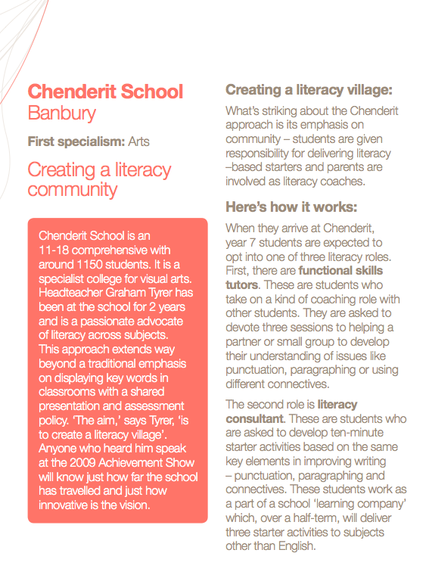
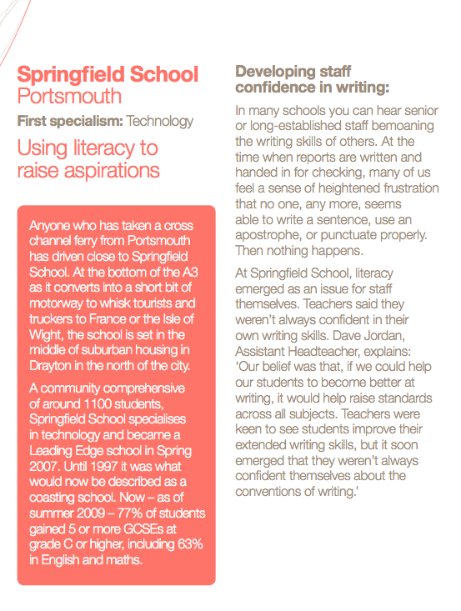
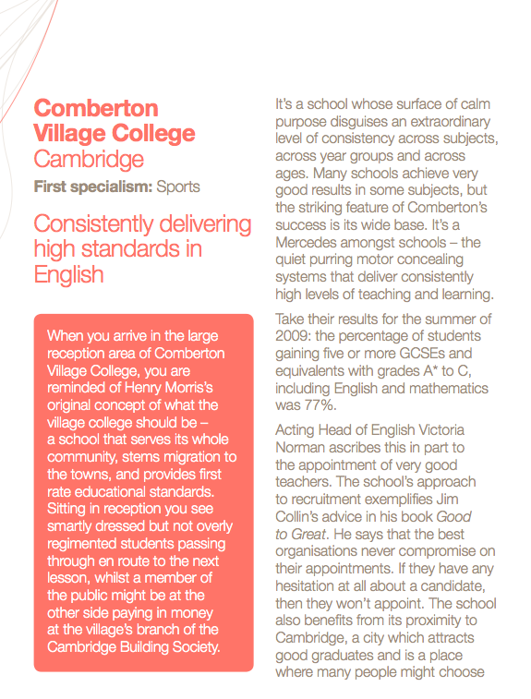

Slide 36
www.geoffbarton.co.uk

Slide 37
English Teacher
Petite, white-haired Miss Cartwright
Knew Shakespeare off by heart,
Or so we pupils thought.
Once in the stalls at the Old Vic
She prompted Lear when he forgot his part.
Ignorant of Scrutiny and Leavis,
She taught Romantic poetry,
Dreamt of gossip with dead poets.
To an amazed sixth form once said: ‘How good to spend a night with Shelley.’
In long war years she fed us plays,
Sophocles to Shaw’s St Joan.
Her reading nights we named our Courting Club,
Yet always through the blacked-out streets
One boy left the girls and saw her home.
When she closed her eyes and chanted
‘Ode to a Nightingale’
We laughed yet honoured her devotion.
We knew the man she should have married
Was killed at Passchendaele.
Brian Cox
From Collected Poems, Carcanet Press 1993.
And finally …

Slide 39
The Yellowing of English
Geoff Barton
NAAE Conference
October 15, 2009
Download this presentation at www.geoffbarton.co.uk

