Slide 1
Don’t call it iteracy
Geoff Barton
Head, King Edward VI School, Suffolk

Slide 2
Today:
Why literacy is the final frontier
How we’re all members of the Literacy Club
It’s all about the classroom

Slide 3
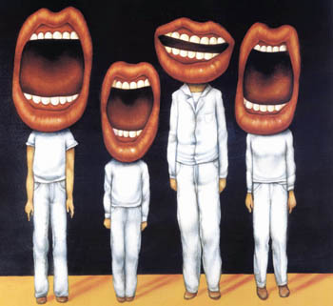
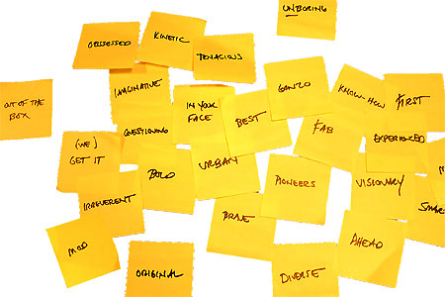
Approach:

Slide 4
Health Check

Slide 5
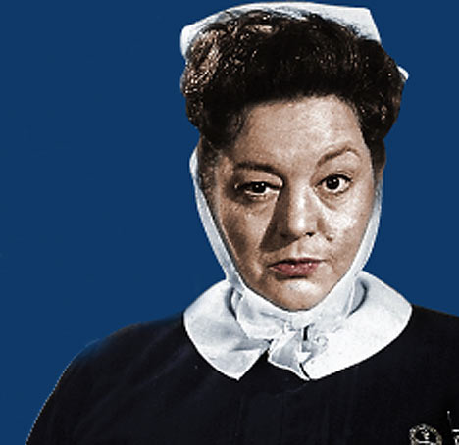

Slide 6
Michael Barber

Slide 7
Literacy standards in England
1945
1997

Slide 8
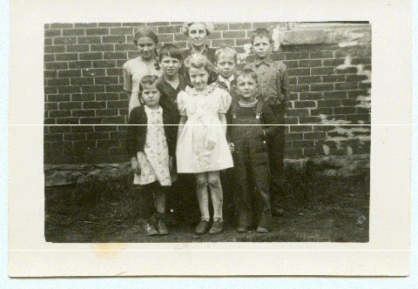

Slide 9
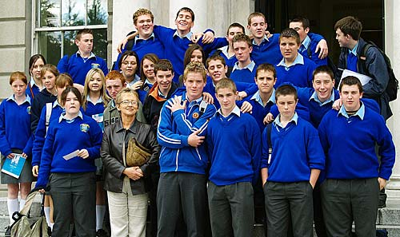

Slide 11
Beacon Schools
Training Schools
Coasting Schools
Super Heads
Consultant Heads
Executive Heads
Schools are becoming immune to school improvement
London Challenge
National Challenge
National Strategies
Leading Edge
Consultants
School improvement partners
Gaining Ground
Leading Light Schools
Trust Schools

Slide 12
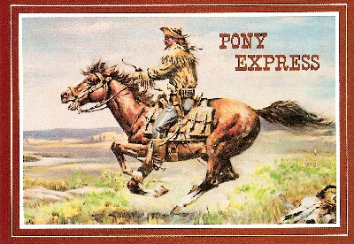

Slide 13
3 Provocations:
1
We haven’t ‘done’ literacy

Slide 14
3 Provocations:
2
Every teacher in English is a teacher of English
George Sampson, 1922

Slide 15
3 Provocations:
3
It’s not about grammar:
it’s about teaching & learning

Slide 16
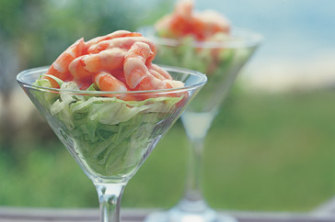
We are part of the literacy club
Literacy is taught - it doesn’t just happen
Literacy today is different from when we were younger

Slide 17
We are part of the literacy club

Slide 18
Guess the Text Type

Slide 19
1 - Where would you find this text?
2 - How do you know?

Slide 20
1
Proud mum in a million Natalie Brown hugged her beautiful baby daughter Casey yesterday and said: “She’s my double miracle.”

Slide 21
2
The blood vessels of the circulatory system, branching into multitudes of very fine tubes (capillaries), supply all parts of the muscles and organs with blood, which carries oxygen and food necessary for life.

Slide 22
3
Ensure that the electrical supply is turned off. Ensure the existing circuit to which the fitting is to be connected has been installed and fused in accordance with current L.L.L wiring regulations

Slide 23
Language oddities

Slide 24
DOGS MUST BE CARRIED ON THE ESCALATOR

Slide 25
Please don't smoke and live a more healthy life
PSHE Poster

Slide 26
Sign at Suffolk hospital:
Criminals operate in this area

Slide 27
ICI FIBRES

Slide 28
Churchdown parish magazine:
‘Would the congregation please note that the bowl at the back of the church labelled “for the sick” is for monetary donations only’

Slide 29
A 1997 survey showed that of 12 European countries, only Poland and Ireland had lower levels of adult literacy
1-in-16 adults cannot identify a concert venue on a poster that contains name of band, price, date, time and venue
7 million UK adults cannot locate the page reference for plumbers in the Yellow Pages

Slide 30
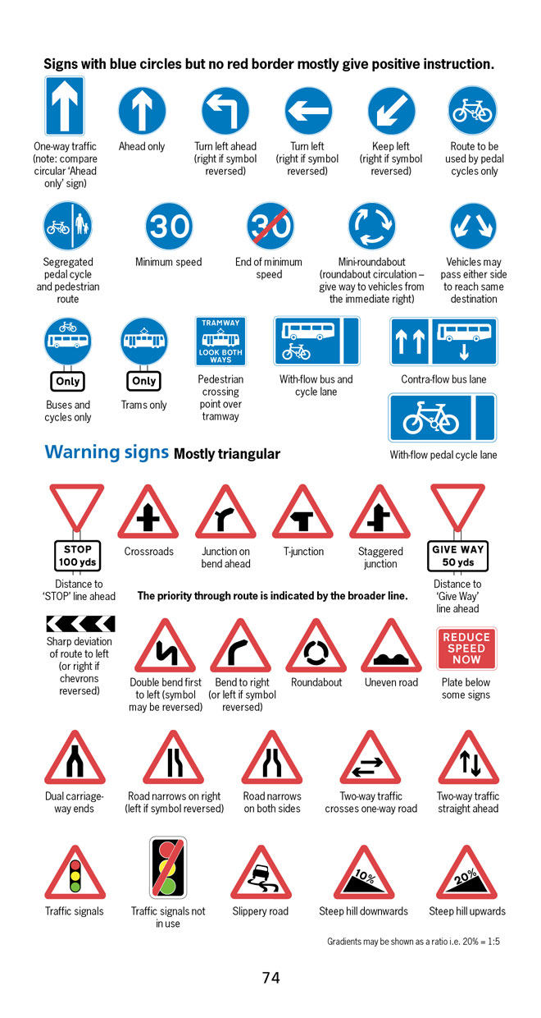
BBC NEWS ONLINE:
More than half of British motorists cannot interpret road signs properly, according to a survey by the Royal Automobile Club.
The survey of 500 motorists highlighted just how many people are still grappling with it.

Slide 31
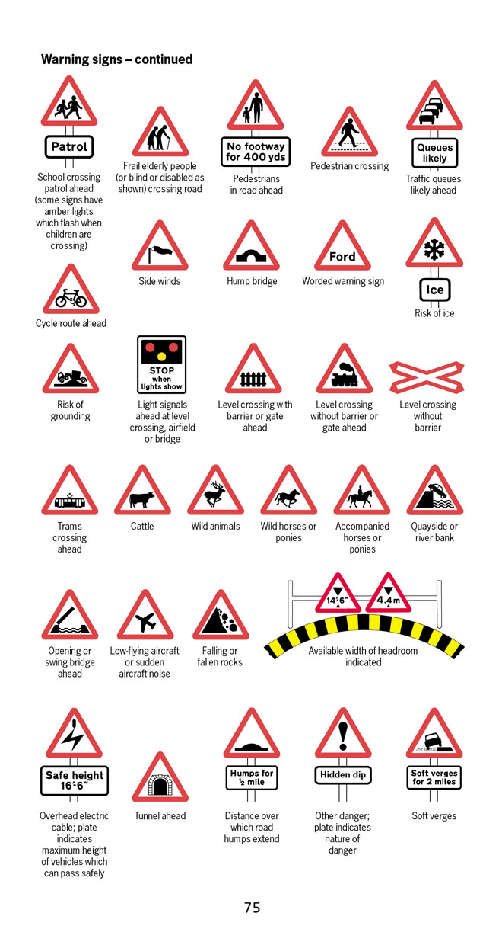
According to the survey, three in five motorists thought a "be aware of cattle" warning sign indicated …
an area infected with foot-and-mouth disease.

Slide 32
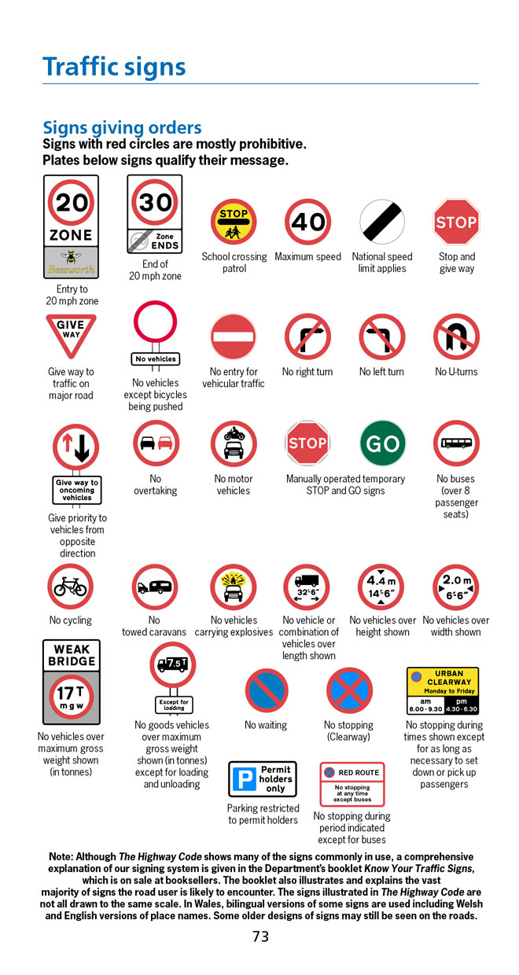
Common mistakes:
No motor vehicles - Beware of fast motorbikes
Wild fowl - Puddles in the road
Riding school close by - "Marlborough country" advert

Slide 33
October 2005: Key findings
Schools do not always seem to understand the importance of pupils’ talk in developing both reading and writing.

Slide 34
October 2005: Key findings
Myhill and Fisher: ‘spoken language forms a constraint, a ceiling not only on the ability to comprehend but also on the ability to write, beyond which literacy cannot progress’.

Slide 35
October 2005: Key findings
Pupils do not improve writing solely by doing more of it; good quality writing benefits from focused discussion that gives pupils a chance to talk through ideas before writing and to respond to friends’ suggestions.

Slide 36
October 2005: Key findings
The Progress in International Reading Literacy Study (PIRLS) 2003: although the reading skills of 10 year old pupils in England compared well with those of pupils in other countries, they read less frequently for pleasure and were less interested in reading than those elsewhere.

Slide 37
October 2005: Key findings
NFER 2003: children’s enjoyment of reading had declined significantly in recent years
A Nestlé/MORI report : ‘underclass’ of non-readers, plus cycles of non-reading ‘where teenagers from families where parents are not readers will almost always be less likely to be enthusiastic readers themselves’.

Slide 38
October 2005: Key findings
Despite the Strategy, weaknesses remain, including:
the stalling of developments as senior management teams focus on other initiatives
lack of robust measures to evaluate the impact of developments across a range of subjects
a focus on writing at the expense of reading, speaking and listening.

Slide 39
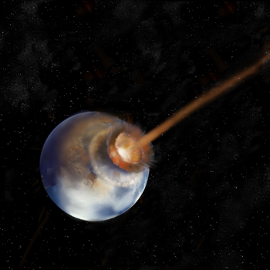
LITERACY
IMPACT
IMPACT

Slide 40
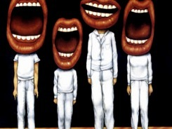
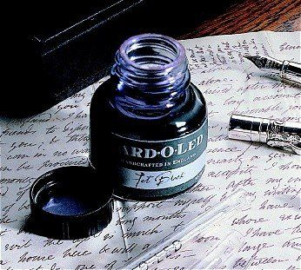

Slide 41
So …?
Understand the significance of exploratory talk
Model good talk – eg connectives
Re-think questioning: why & how?
Re-think hands-up
Get conversations into the school culture

Slide 42
Teach reading – scanning, skimming, analysis
Read aloud and display
Teach key vocabulary
Demystify spelling
Teach research, not FOFO

Slide 43
SKIMMING

Slide 44
The climate of the Earth is always changing. In the past it has altered as a result of natural causes. Nowadays, however, the term climate change is generally used when referring to changes in our climate which have been identified since the early part of the 1900's . The changes we've seen over recent years and those which are predicted over the next 80 years are thought to be mainly as a result of human behaviour rather than due to natural changes in the atmosphere.

Slide 45
The best treatment for mouth ulcers. Gargle with salt water. You should find that it works a treat. Salt is cheap and easy to get hold of and we all have it at home, so no need to splash out and spend lots of money on expensive mouth ulcer creams.

Slide 46
Urquhart castle is probably one of the most picturesquely situated castles in the Scottish Highlands. Located 16 miles south-west of Inverness, the castle, one of the largest in Scotland, overlooks much of Loch Ness. Visitors come to stroll through the ruins of the 13th-century castle because Urquhart has earned the reputation of being one of the best spots for sighting Loch Ness’s most famous inhabitant.

Slide 47
SCANNING

Slide 48
Where did the first cell phones begin?
Name 2 other features that started to be included in phones
Why are cell phones especially useful in some countries?

Slide 49
Where begin?
Two features?
Some countries?
Cellular telephones
The first cellular telephone system began operation in Tokyo in 1979, and the first U.S. system began operation in 1983 in Chicago. A camera phone is a cellular phone that also has picture taking capabilities. Some camera phones have the capability to send these photos to another cellular phone or computer. Advances in digital technology and microelectronics has led to the inclusion of unrelated applications in cellular telephones, such as alarm clocks, calculators, Internet browsers, and voice memos for recording short verbal reminders, while at the same time making such telephones vulnerable to certain software viruses. In many countries with inadequate wire-based telephone networks, cellular telephone systems have provided a means of more quickly establishing a national telecommunications network.

Slide 50
CLOSE READING

Slide 51
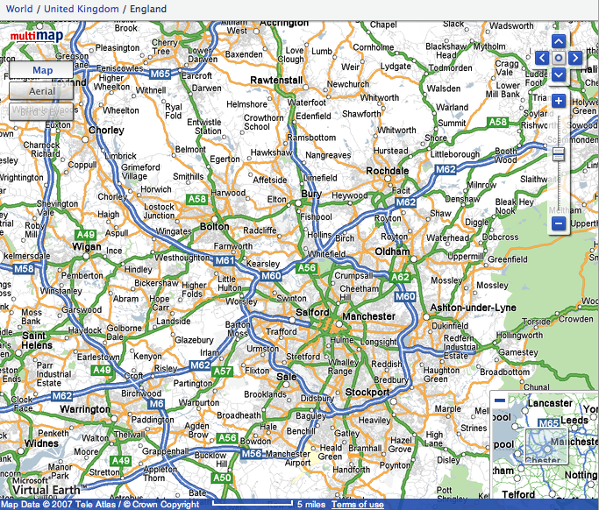

Slide 52
Get me from Whitworth (above Rochdale) to Manchester Airport (bottom centre)
Write down a village that is due west of Bolton
Write down a village that is due south of Sale
Name 4 villages on the A58
Write down 4 villages (not towns) that are within the M60 motorway
Find and then describe where these villages are (use words like just to the west of …):
a) Pemberton
b) Lumb
c) Dobcross

Slide 53
Research skills, not FOFO

Slide 54
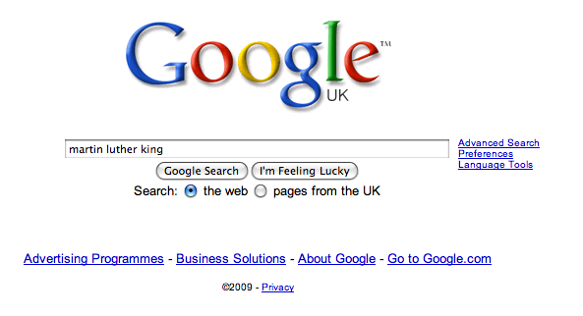

Slide 62
DEMYSTIFYING
SPELLING

Slide 63
MNEMONICS

Slide 64
necessary

Slide 65
Words within words

Slide 66
Se-para-te
Be-lie-ve

Slide 67
SOUNDS

Slide 68
Govern+ment

Slide 69
SPELLING STARTERS

Slide 70
-ible -able

Slide 71
Homophones
Sound of Music Kylie Beethoven
their there they’re
too two to
pray prey

Slide 72
Hard
Homophones
Freeze Stand
advice advise
practice practise
effect affect
It’s its

Slide 73
So …?
Teach reading – scanning, skimming, analysis
Read aloud and display
Teach key vocabulary
Demystify spelling
Teach research, not FOFO

Slide 74
Demonstrate writing
Teach composition & conventions
Allow oral rehearsal
Short & long sentences
Connectives

Slide 75
WRITE NOW

Slide 76
Describe this room

Slide 78
Demonstrate writing
Teach composition & conventions
Allow oral rehearsal
Short & long sentences
Connectives

Slide 79
Know your connectives
Adding: and, also, as well as, moreover, too
Cause & effect: because, so, therefore, thus, consequently
Sequencing: next, then, first, finally, meanwhile, before, after
Qualifying: however, although, unless, except, if, as long as, apart from, yet
Emphasising: above all, in particular, especially, significantly, indeed, notably
Illustrating: for example, such as, for instance, as revealed by, in the case of
Comparing: equally, in the same way, similarly, likewise, as with, like
Contrasting: whereas, instead of, alternatively, otherwise, unlike, on the other hand

Slide 80
So …?
Demonstrate writing
Teach composition & conventions
Allow oral rehearsal
Short & long sentences
Connectives

Slide 81
LITERACY
IMPACT
Over to you …

Slide 82
Don’t call it iteracy
Geoff Barton
Head, King Edward VI School, Suffolk

