Slide 1
Developing Future Leaders
Geoff Barton & Andrew McLellan
King Edward VI School
Bury St Edmunds

Slide 2
1 Our in-house leadership development programme: the rhetoric
2 The reality
3 Some thoughts on the kinds of leaders schools of the future will need

Slide 3
1 Application process
King Edward VI School:
Leadership Development Programme
2 10 after-school sessions
3 1 mini-day conference
4 “Go Away” days

Slide 4
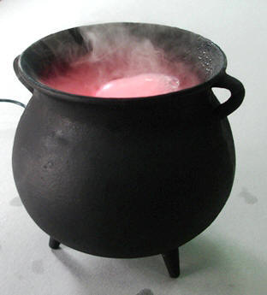
Plus …
Cross-phase participation
Micro-skills
Faking it
Student feedback

Slide 5
Developing Future Leaders
Andrew McLellan
Division Leader

Slide 7
1 Understand Bill Clinton

Slide 8
2 Be intolerant of mediocrity

Slide 9
3 Bring solutions rather than problems

Slide 10
4 Know that leadership is about judgement*, not experience

Slide 11
5 Understand that standards and ECM are not separate

Slide 12
6 Know that the only future is system leadership

Slide 14
Developing Future Leaders
Geoff Barton & Andrew McLellan
Email us if you’d like resources from our programme:
geoffbarton@mac.com
www.king-ed.suffolk.sch.uk

