Slide 1
Mr B’s GCSE
A/A*English Masterclass

Slide 2
2¼ hours
Notes:
In 2 ¼ hours

Slide 3
2 things
Notes:
In 2 ¼ hours

Slide 4
1: Read stuff

Slide 5
2: Write stuff

Slide 6
1: Read stuff

Slide 11
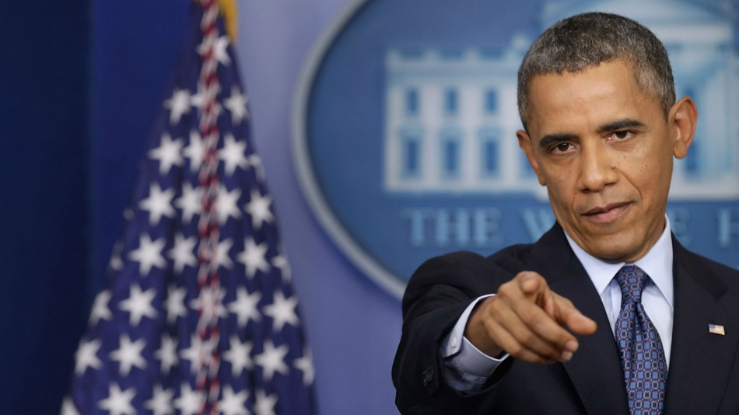

Slide 12
2: Write stuff

Slide 13
Explain / describe
(25 minutes)

Slide 14
Persuade / argue
(35 mins)

Slide 15
2¼
Notes:
In 2 ¼ hours

Slide 16
1: Reading

Slide 17
Make it active

Slide 18
QUESTION 1:
Retrieval and inference
8 marks
‘What do you understand about the Amazon tribe and the issues it faces?’

Slide 19
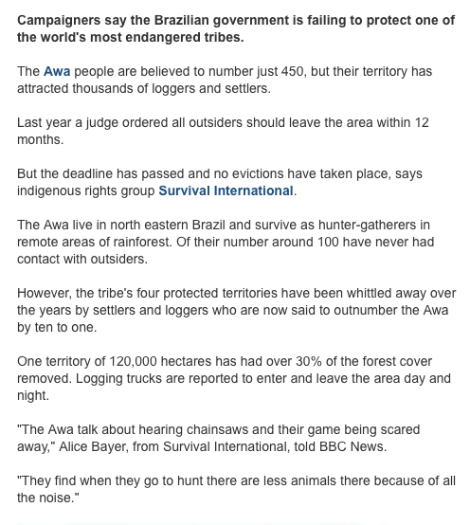
‘What do you understand about the Amazon tribe and the issues it faces?’
Look for and in question
Make 3 points: beginning, middle and end
Notice words and comment on them using very short quotations
Think ‘how?’ and ‘why?’

Slide 20
QUESTION 2:
Presentational Features (8 marks)
‘Explain how the headline and picture are effective and how they link to the text’

Slide 21
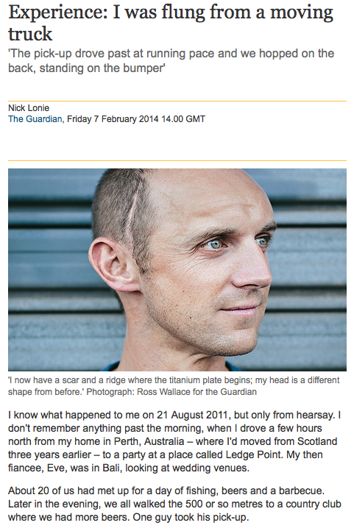
‘Explain how the headline and picture are effective and how they link to the text’
Look for and in question
Write 3 paragraphs:
1: Headline
2: Image
3: Similarities and contradictions with text
Think ‘how?’ and ‘why?’

Slide 22
QUESTION 3:
Focus on the writer’s thoughts and feelings
(8 marks)
‘Explain the thoughts and feelings the writer has during his encounter with the bear’

Slide 23
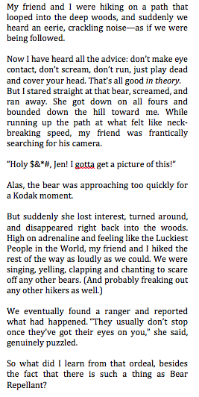
Write 3 paragraphs:
1: Start
2: Middle
3: End
Notice words showing feelings and comment on them using very short quotations
Show how the writer’s feelings change
‘Explain the thoughts and feelings the writer has during his encounter with the bear’

Slide 24
QUESTION 4:
Compare two texts commenting on language (16 marks)
‘Compare the ways in which language is used for effect in the two texts’

Slide 25
Write 3 or 4 paragraphs:
1: Start
2: Middle
3: End
Notice words in each text – similar / different
Formal?
Colloquial?
Technical?
Emotional?
Poetic?
Complex or simple?
Short embedded quotes
‘Compare the ways in which language is used for effect in the two texts’

Slide 26
WORDS TO USE:
1: Words about thoughts and feelings:
emotional, vivid, memorable, emotive, harsh, comic, formal, impersonal, scientific, technical, sensuous, positive, nervous, agitated, apprehensive, proud, arrogant, negative, pleased, worried, anxious
2: Words to analyse texts
Shows, demonstrates, implies, portrays, depicts, presents, might, may, seems

Slide 27
Reading:
45 mins = Q1,2,3
30 mins = Q4

Slide 28
2: Writing

Slide 29
Explain / describe
(25 minutes)

Slide 30
Write a blog describing a place of interest in your area
Write a letter explaining why you disagree with school uniform
Write an article informing people about how young people are often stereotyped in the media
Be clear
Be structured:
5 paragraphs
Be specific – examples
Use short and long sentences
2+ sides

Slide 31
Persuade / argue
(35 mins)

Slide 32
Be opinionated
Be varied: questions, statistics, quotations, stories
Choose interesting words
Use short and long sentences
2½ - 3 sides
Write an article persuading readers that we should take more responsibility for the environment
Write an article arguing that reality television is harmful

Slide 33
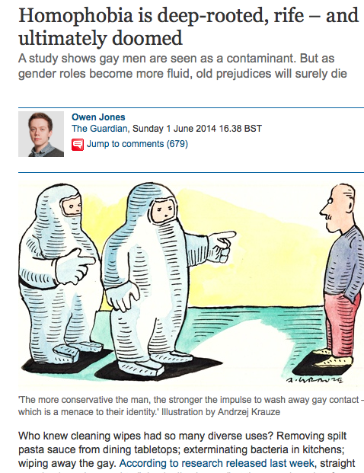
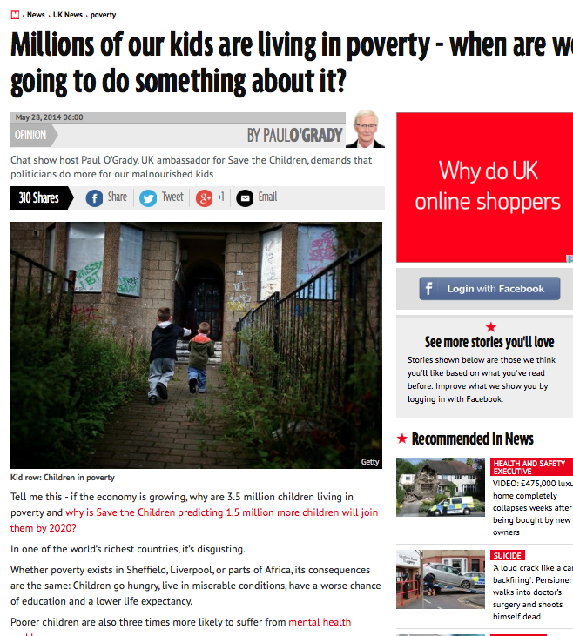
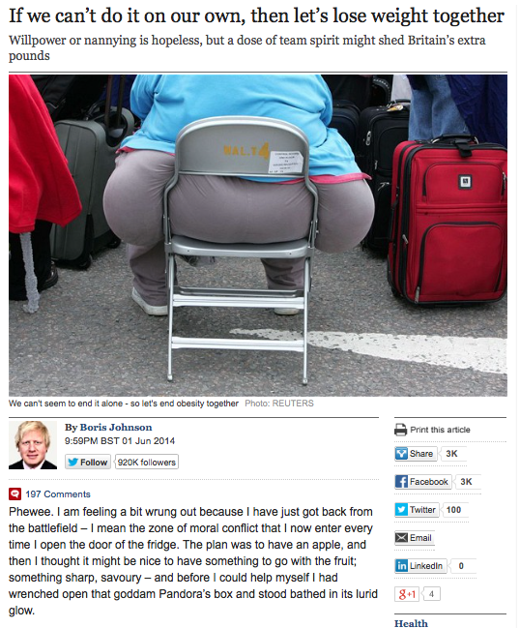
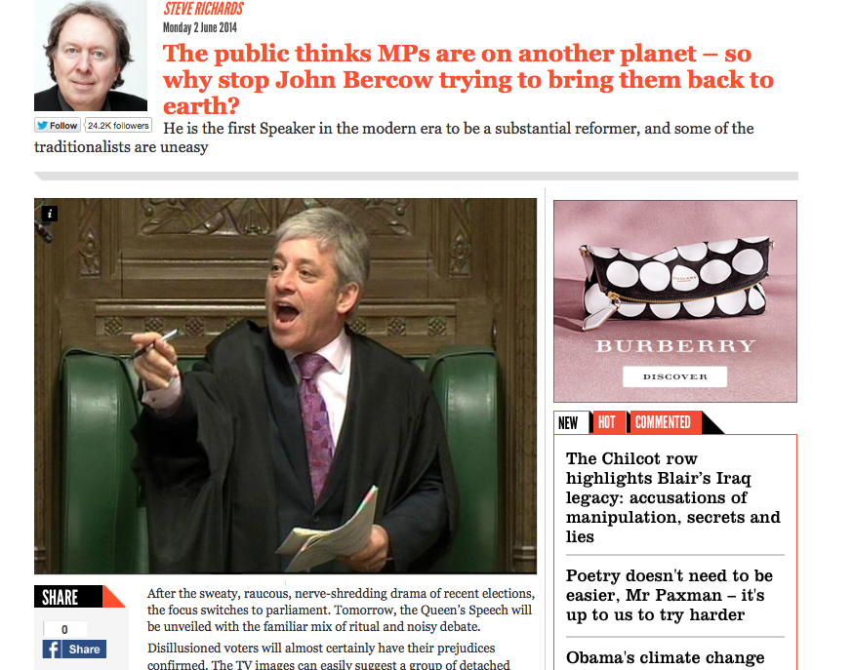
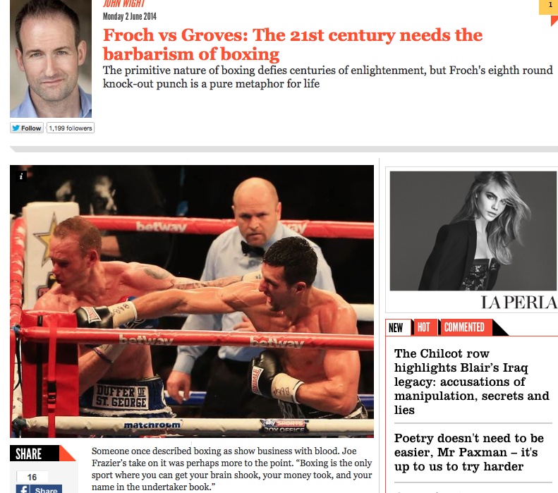

Slide 34
Some people believe far-flung holiday destinations are a waste of money and damage the planet. Write an article explaining why you agree or disagree with this view.
Jeremy Clarkson, Sunday Times

Slide 35
For your next holiday, why don’t you take all your money and put it on the fire? Then stand in a fridge for a week, beating your children with a baseball bat until their arms and legs break. And then, after you’ve eaten some melted cheese, dislocate your shoulder. If all of this appeals then you are probably one of the 1.3 million British people …
… who go on a skiing holiday at this time of year.

Slide 36
2¼ hours
Notes:
In 2 ¼ hours

Slide 37
2 things
Notes:
In 2 ¼ hours

Slide 38
1: Read stuff

Slide 39
2: Write stuff

Slide 40
45 mins = Q1,2,3
90 mins = Q4
60 mins = Q5
30 mins = Q6
5 mins = Wrap up

Slide 41
Preparing …

Slide 43
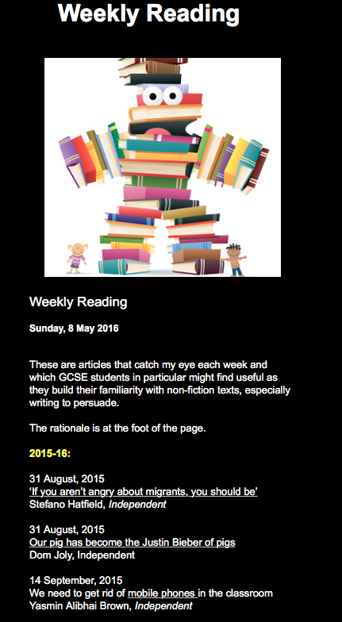
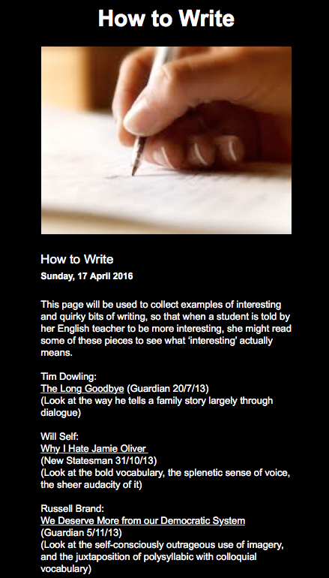

Slide 44
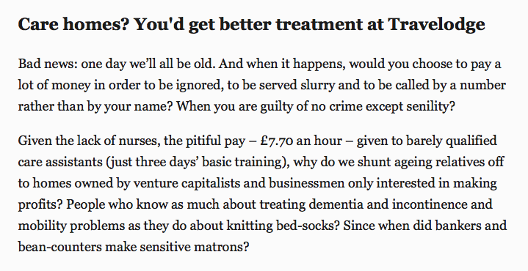
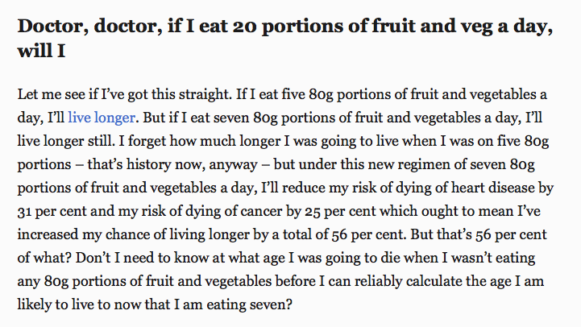
Howard Jacobson, Independent
Janet Street-Porter, Independent

Slide 45
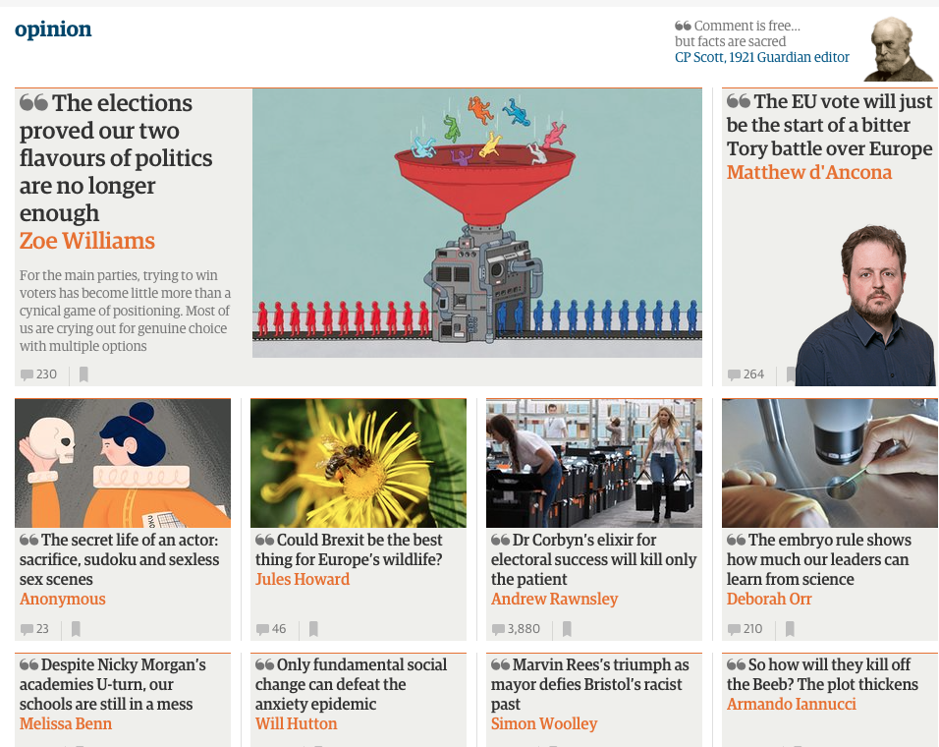
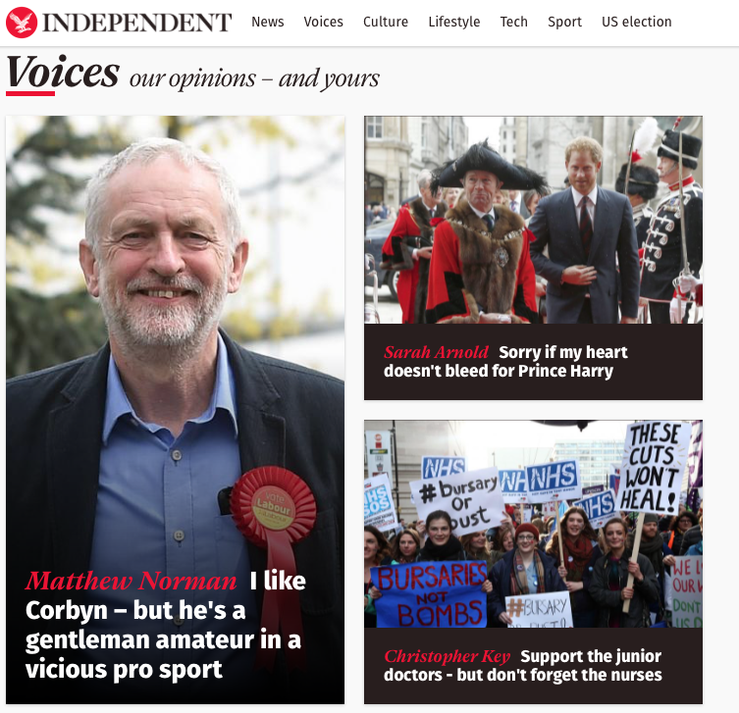

Slide 46
Mr B’s GCSE
A/A*English Masterclass

Slide 47
Mr B’s GCSE
A/A*English Masterclass

