Slide 1
English GCSE: Make it an A*

Slide 2
What

Slide 3
How

Slide 5
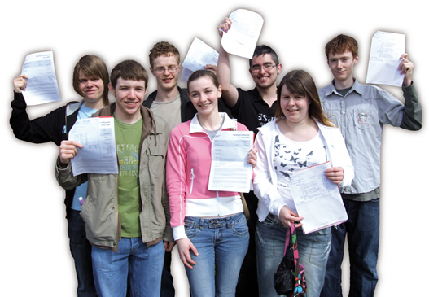

Slide 6
What

Slide 7
A* students need to:
consider alternative interpretations in poetry analysis
evaluate the writer's techniques
use technical vocabulary to describe language
independently analyse texts and be original in their interpretations
use sophisticated vocabulary
experiment with language for effect
be original in their writing

Slide 8
Key words:
original
sophisticated
impressive

Slide 9
PAPER 1

Slide 11
1:
Reading non-fiction:
understand / presentation / language
Writing to argue / persuade / advise

Slide 12
PAPER 2

Slide 13
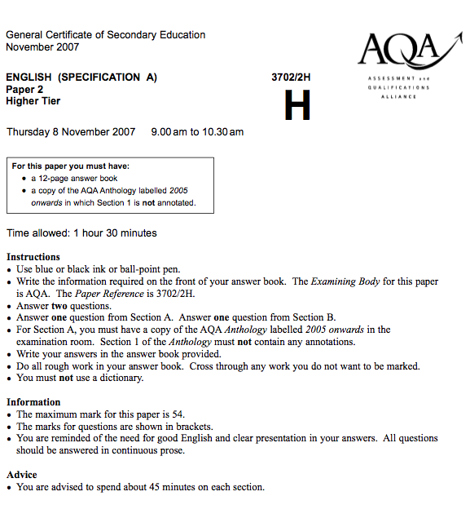

Slide 14
2:
Reading poetry
Writing to inform / explain / describe

Slide 15
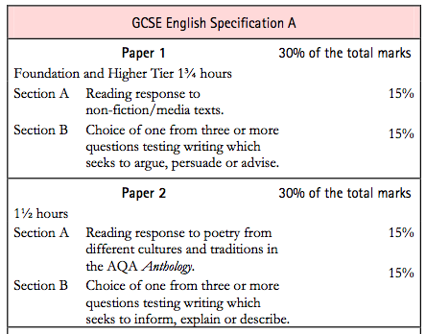

Slide 16
PAPER 1

Slide 18
PAPER 2

Slide 19
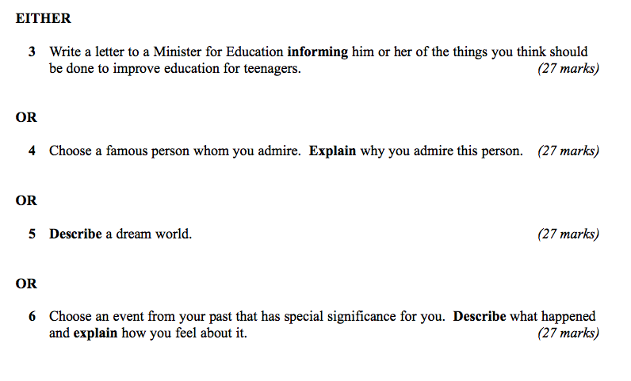

Slide 20
WRITING

Slide 21
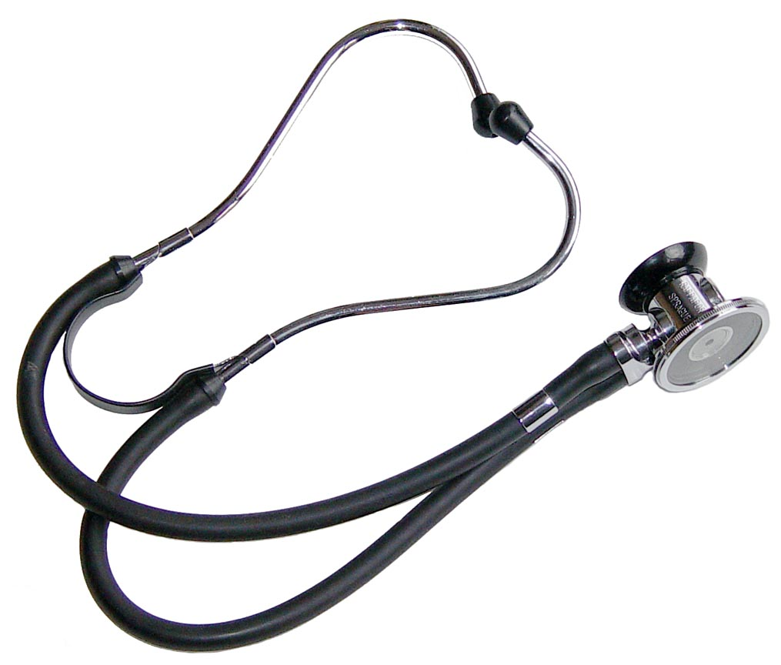

Slide 22
Describe a place that means a lot to you

Slide 24
5
Approaches I wish someone had taught me

Slide 25
1: Sentence Variety

Slide 26
Short and long sentences
Less “and” and “but”
Link with “that”, “who”, “which”
Use 2-part sentences:
As …, …
Although …, …
If …, …
-ing …, …
-ed …, …

Slide 27
2: Vivid vocabulary: Think senses Think metaphors

Slide 28
3: Tone changers: Questions – statements – dialogue – statistics

Slide 29
4: Surprise us (eg pronouns / narrative disjuncture)

Slide 30
5: Advanced punctuation: : ; (,,)

Slide 31
Describe a person you admire

Slide 32
Write a letter to your headteacher asking for more PE and sport

Slide 33
READING

Slide 34
Content?
Style?

Slide 35
MYSTERY TEXTS

Slide 36
The climate of the Earth is always changing. In the past it has altered as a result of natural causes. Nowadays, however, the term climate change is generally used when referring to changes in our climate which have been identified since the early part of the 1900's . The changes we've seen over recent years and those which are predicted over the next 80 years are thought to be mainly as a result of human behaviour rather than due to natural changes in the atmosphere.

Slide 37
The best treatment for mouth ulcers. Gargle with salt water. You should find that it works a treat. Salt is cheap and easy to get hold of and we all have it at home, so no need to splash out and spend lots of money on expensive mouth ulcer creams.

Slide 38
The best treatment for mouth ulcers. Gargle with salt water. You should find that it works a treat. Salt is cheap and easy to get hold of and we all have it at home, so no need to splash out and spend lots of money on expensive mouth ulcer creams.

Slide 39
Urquhart castle is probably one of the most picturesquely situated castles in the Scottish Highlands. Located 16 miles south-west of Inverness, the castle, one of the largest in Scotland, overlooks much of Loch Ness. Visitors come to stroll through the ruins of the 13th-century castle because Urquhart has earned the reputation of being one of the best spots for sighting Loch Ness’s most famous inhabitant.

Slide 40
Urquhart castle is probably one of the most picturesquely situated castles in the Scottish Highlands. Located 16 miles south-west of Inverness, the castle, one of the largest in Scotland, overlooks much of Loch Ness. Visitors come to stroll through the ruins of the 13th-century castle because Urquhart has earned the reputation of being one of the best spots for sighting Loch Ness’s most famous inhabitant.

Slide 41
Urquhart castle is probably one of the most picturesquely situated castles in the Scottish Highlands. Located 16 miles south-west of Inverness, the castle, one of the largest in Scotland, overlooks much of Loch Ness. Visitors come to stroll through the ruins of the 13th-century castle because Urquhart has earned the reputation of being one of the best spots for sighting Loch Ness’s most famous inhabitant.

Slide 42
Urquhart castle is probably one of the most picturesquely situated castles in the Scottish Highlands. Located 16 miles south-west of Inverness, the castle, one of the largest in Scotland, overlooks much of Loch Ness. Visitors come to stroll through the ruins of the 13th-century castle because Urquhart has earned the reputation of being one of the best spots for sighting Loch Ness’s most famous inhabitant.

Slide 43
Urquhart castle is probably one of the most picturesquely situated castles in the Scottish Highlands. Located 16 miles south-west of Inverness, the castle, one of the largest in Scotland, overlooks much of Loch Ness. Visitors come to stroll through the ruins of the 13th-century castle because Urquhart has earned the reputation of being one of the best spots for sighting Loch Ness’s most famous inhabitant.

Slide 44
Urquhart castle is probably one of the most picturesquely situated castles in the Scottish Highlands. Located 16 miles south-west of Inverness, the castle, one of the largest in Scotland, overlooks much of Loch Ness. Visitors come to stroll through the ruins of the 13th-century castle because Urquhart has earned the reputation of being one of the best spots for sighting Loch Ness’s most famous inhabitant.

Slide 45
Urquhart castle is probably one of the most picturesquely situated castles in the Scottish Highlands. Located 16 miles south-west of Inverness, the castle, one of the largest in Scotland, overlooks much of Loch Ness. Visitors come to stroll through the ruins of the 13th-century castle because Urquhart has earned the reputation of being one of the best spots for sighting Loch Ness’s most famous inhabitant.

Slide 46
Urquhart castle is probably one of the most picturesquely situated castles in the Scottish Highlands. Located 16 miles south-west of Inverness, the castle, one of the largest in Scotland, overlooks much of Loch Ness. Visitors come to stroll through the ruins of the 13th-century castle because Urquhart has earned the reputation of being one of the best spots for sighting Loch Ness’s most famous inhabitant.

Slide 47
Urquhart castle is probably one of the most picturesquely situated castles in the Scottish Highlands. Located 16 miles south-west of Inverness, the castle, one of the largest in Scotland, overlooks much of Loch Ness. Visitors come to stroll through the ruins of the 13th-century castle because Urquhart has earned the reputation of being one of the best spots for sighting Loch Ness’s most famous inhabitant.

Slide 48
Urquhart castle is probably one of the most picturesquely situated castles in the Scottish Highlands. Located 16 miles south-west of Inverness, the castle, one of the largest in Scotland, overlooks much of Loch Ness. Visitors come to stroll through the ruins of the 13th-century castle because Urquhart has earned the reputation of being one of the best spots for sighting Loch Ness’s most famous inhabitant.

Slide 49
1Type of Text? 2Topic?
The beginning of the bassoon is similar to the oboe. The bassoon itself first appeared about 1650, and by the end of the 1700’s, it had from 4 to 8 keys. During the 1800’s, many people experimented with improving the fingering of the bassoon. Most of the changes helped the fingering, but made the tone of the instrument suffer. The Heckel family of Germany managed to improve the fingering of the bassoon without damaging its tone. Many professionals today play bassoons made by the Heckel Company.The bassoon is the lowest and largest of the woodwinds. Its sound has a lot of variety, depending on if low, medium or high notes are used. In the very highest range, the bassoon can sound throaty and not of this world. In its mid-range, the bassoon has a large, full, mellow noise. In the lowest range, it can be extremely powerful and heavy.

Slide 50
1Type of Text? 2Topic?
The beginning of the bassoon is similar to the oboe. The bassoon itself first appeared about 1650, and by the end of the 1700’s, it had from 4 to 8 keys. During the 1800’s, many people experimented with improving the fingering of the bassoon. Most of the changes helped the fingering, but made the tone of the instrument suffer. The Heckel family of Germany managed to improve the fingering of the bassoon without damaging its tone. Many professionals today play bassoons made by the Heckel Company.The bassoon is the lowest and largest of the woodwinds. Its sound has a lot of variety, depending on if low, medium or high notes are used. In the very highest range, the bassoon can sound throaty and not of this world. In its mid-range, the bassoon has a large, full, mellow noise. In the lowest range, it can be extremely powerful and heavy.

Slide 51
1Type of Text? 2Topic?
The beginning of the bassoon is similar to the oboe. The bassoon itself first appeared about 1650, and by the end of the 1700’s, it had from 4 to 8 keys. During the 1800’s, many people experimented with improving the fingering of the bassoon. Most of the changes helped the fingering, but made the tone of the instrument suffer. The Heckel family of Germany managed to improve the fingering of the bassoon without damaging its tone. Many professionals today play bassoons made by the Heckel Company.The bassoon is the lowest and largest of the woodwinds. Its sound has a lot of variety, depending on if low, medium or high notes are used. In the very highest range, the bassoon can sound throaty and not of this world. In its mid-range, the bassoon has a large, full, mellow noise. In the lowest range, it can be extremely powerful and heavy.

Slide 52
1Type of Text? 2Topic?
The beginning of the bassoon is similar to the oboe. The bassoon itself first appeared about 1650, and by the end of the 1700’s, it had from 4 to 8 keys. During the 1800’s, many people experimented with improving the fingering of the bassoon. Most of the changes helped the fingering, but made the tone of the instrument suffer. The Heckel family of Germany managed to improve the fingering of the bassoon without damaging its tone. Many professionals today play bassoons made by the Heckel Company.The bassoon is the lowest and largest of the woodwinds. Its sound has a lot of variety, depending on if low, medium or high notes are used. In the very highest range, the bassoon can sound throaty and not of this world. In its mid-range, the bassoon has a large, full, mellow noise. In the lowest range, it can be extremely powerful and heavy.
History of the Bassoon
http://library.thinkquest.org

Slide 53
MYSTERY TEXTS

Slide 54
The Life of Charles Dickens
Chapter 1
CHARLES DICKENS, the most popular novelist of the century, and one of the greatest humorists that England has produced, was born at Lanport, in Portsea, on Friday, the seventh of February, 1812.
His father, John Dickens, a clerk in the navy pay-office, was at this time stationed in the Portsmouth Dockyard. He had made acquaintance with the lady, Elizabeth Barrow, who became afterwards his wife, through her elder brother, Thomas Barrow, also engaged on the establishment at Somerset House, and she bore him in all a family of eight children, of whom two died in infancy. The eldest, Fanny (born 1810), was followed by Charles (entered in the baptismal register of Portsea as Charles John Huffham, though on the very rare occasions when he subscribed that name he wrote Huffam); by another son, named Alfred, who died in childhood; by Letitia (born 1816); by another daughter, Harriet, who died also in childhood; by Frederick (born 1820); by Alfred Lamert (born 1822); and by Augustus (born 1827).

Slide 55
DICKENS
CHARLES DICKENS was dead. He lay on a narrow green sofa – but there was room enough for him, so spare had he become – in the dining room of Gad’s Hill Place. He had died in the house which he had first seen as a small boy and which his father had pointed out to him as a suitable object of his ambitions; so great was his father’s hold upon his life that, forty years later, he had bought it. Now he had gone. It was customary to close the blinds and curtains, thus enshrouding the corpse in darkness before its last journey to the tomb; but in the dining room of Gad’s Hill the curtains were pulled apart and on this June day the bright sunshine streamed in, glittering on the large mirrors around the room. The family beside him knew how he enjoyed the light, how he needed the light; and they understood, too, that none of the conventional sombreness of the late Victorian period – the year was 1870 – had ever touched him.
All the lines and wrinkles which marked the passage of his life were new erased in the stillness of death. He was not old – he died in his fifty-eighth year – but there had been signs of premature ageing on a visage so marked and worn; he had acquired, it was said, a “sarcastic look”. But now all that was gone and his daughter, Katey, who watched him as he lay dead, noticed how there once more emerged upon his face “beauty and pathos”.

Slide 56
It was a bitterly cold day. Everyone was in black. The cars were black too. There were people standing around in a group waiting for the coffin. Crows were flying in the sky. It was really eerie.

Slide 57
The undertaker's men were like crows, stiff and black, and the cars were black, lined up beside the path that led to the church; and we, we too were black, as we stood in our pathetic, awkward group waiting for them to lift out the coffin and shoulder it, and for the clergyman to arrange himself; and he was another black crow in his long cloak.
And then the real crows rose suddenly from the trees and from the fields, whirled up like scraps of blackened paper from a bonfire, and circled, caw-caw-ing above our heads.

Slide 58
English GCSE: Make it an A*

Slide 59
A* students need to:
consider alternative interpretations in poetry analysis
evaluate the writer's techniques
use technical vocabulary to describe language
independently analyse texts and be original in their interpretations
use sophisticated vocabulary
experiment with language for effect
be original in their writing

Slide 60
Key words:
original
sophisticated
impressive

Slide 61
English GCSE: Make it an A*

