Slide 1
English GCSE: C or higher – guaranteed!
Thursday, March 10, 2011

Slide 2
Hello.

Slide 3
Getting a C in English is easier than you think

Slide 4
Today

Slide 5
Write better
Read better
Spell better

Slide 6
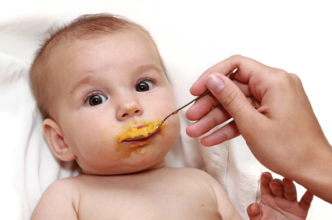
x

Slide 7
What

Slide 8
How

Slide 9
2

Slide 10
1 – Listen
2 - Practise

Slide 11
Visualise what success will feel like

Slide 13
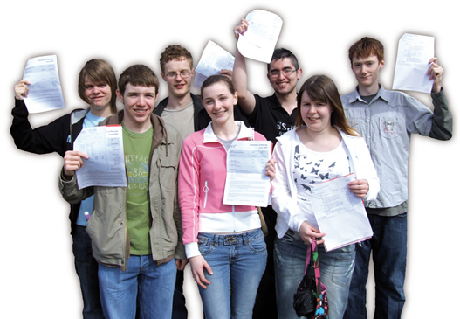

Slide 15
What

Slide 16
English -v-
English Literature

Slide 17
PAPER 1

Slide 18
1:
Reading non-fiction:
understand / presentation / language
Writing to argue / persuade / advise

Slide 20
Read

Slide 21
Write

Slide 22
Foundation

Slide 23
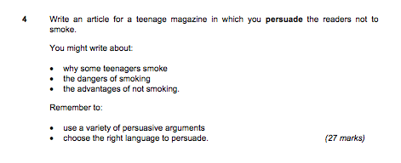

Slide 24
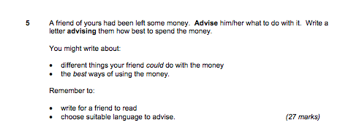

Slide 25
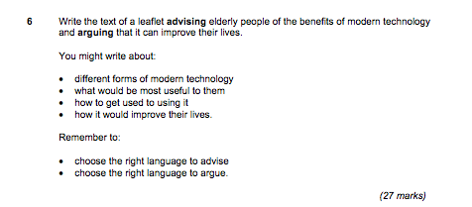

Slide 26
Higher

Slide 30
PAPER 2

Slide 31
2:
Reading poetry
Writing to inform / explain / describe

Slide 32
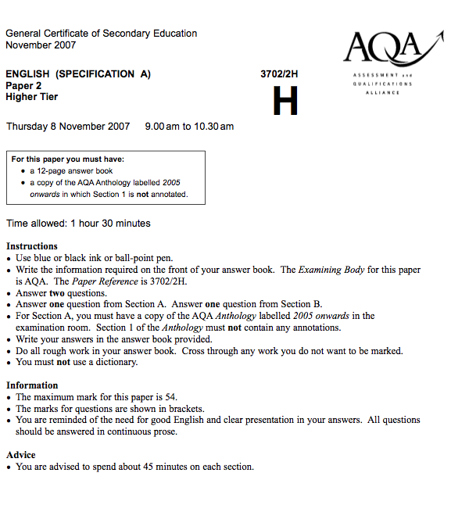

Slide 33
Foundation

Slide 34
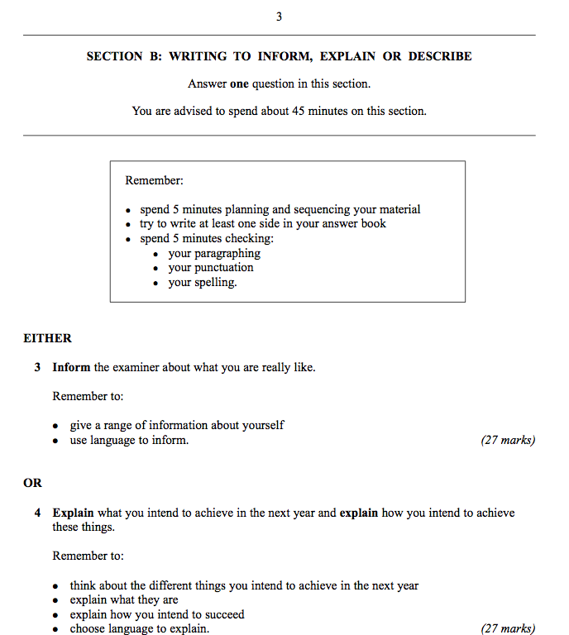

Slide 35
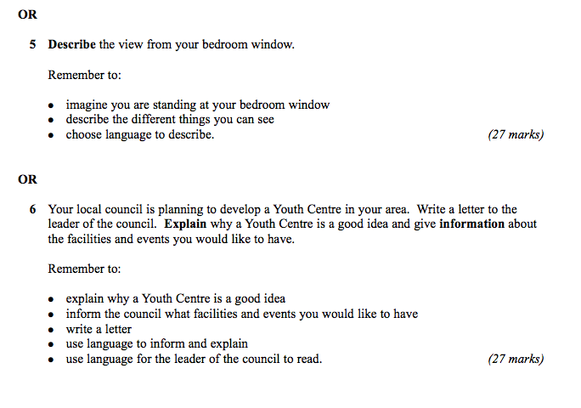

Slide 36
Higher

Slide 37
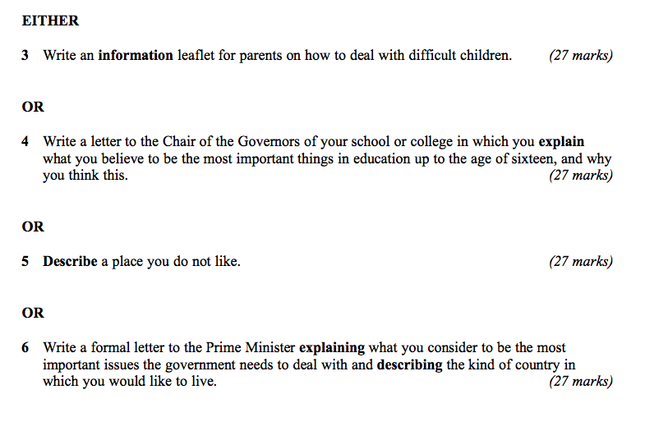

Slide 38
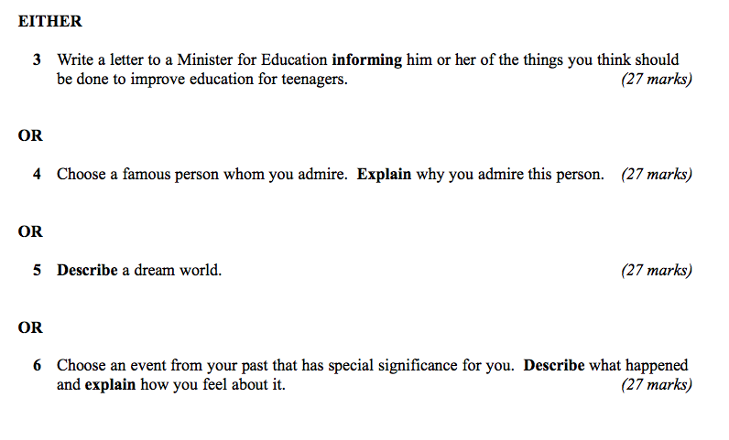

Slide 39
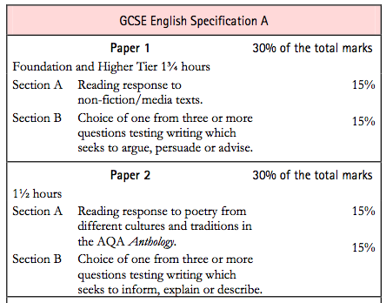

Slide 40
Today:
Write better
Plan better
Spell better

Slide 41
What

Slide 42
How

Slide 44
Describe a place that is special to you

Slide 46
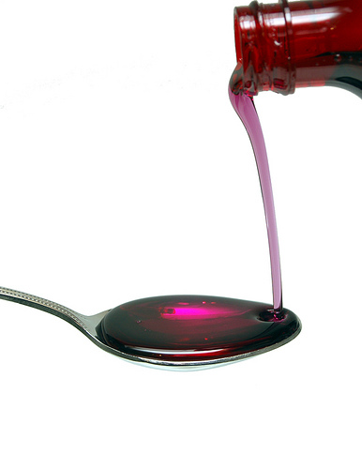

Slide 47
3

Slide 48
1: You find it hard to come up with ideas / to get started / to keep going …
2: You’re not very confident about writing accurately / being interesting
3: You’re not sure how to revise for English /you lack concentration …

Slide 49
1: How to write better

Slide 50
Make your sentences shorter: 12 words.
Make some much shorter: 3 – 5 words.
Use “and” less
Join some sentences with “that”, “who”, “which”
Write some 2 part sentences starting with “As …, …”, “Although …, …”, “When …, …”

Slide 51
2: How to plan better

Slide 52
Choose the right question: description and letters are most straightforward
Do a spider diagram of ideas, then number them 5-7 for paragraphing
Use:
Vivid description
Dialogue
Questions
Then & now
For & against

Slide 53
Practise …

Slide 54
Describe a person you admire

Slide 55
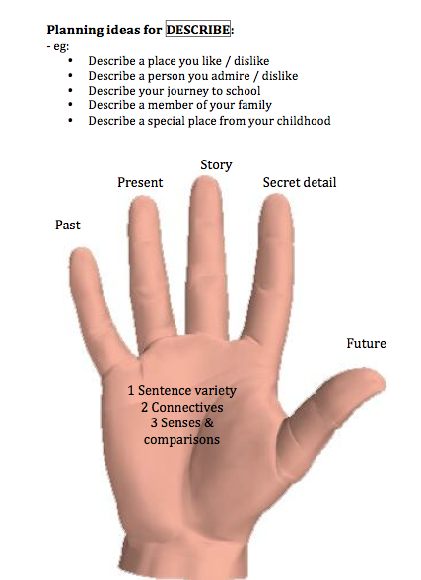

Slide 56
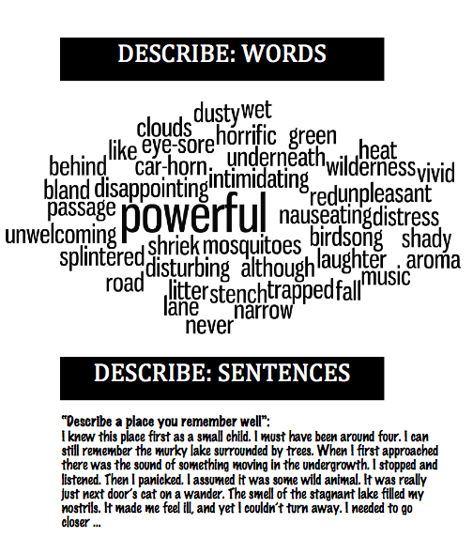

Slide 57
Write a letter to your headteacher asking for more PE and sport

Slide 58
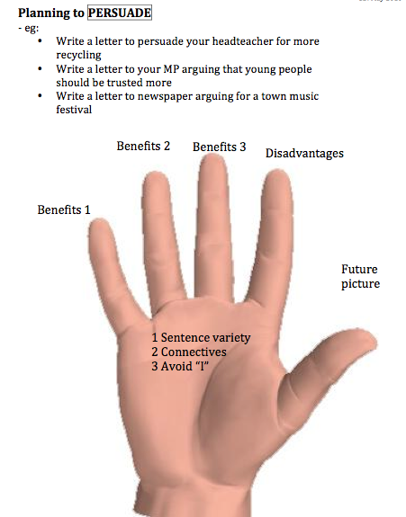

Slide 59
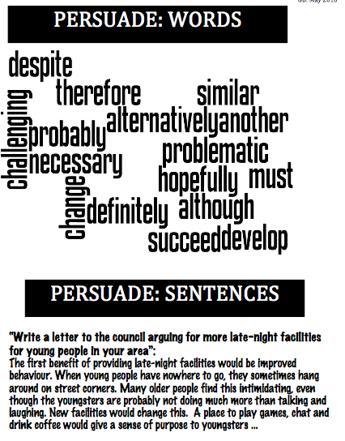

Slide 60
English GCSE: Grade C – guaranteed!
www.geoffbarton.co.uk

Slide 61
READING

Slide 62
What?
How?

Slide 63
MYSTERY TEXTS

Slide 64
The climate of the Earth is always changing. In the past it has altered as a result of natural causes. Nowadays, however, the term climate change is generally used when referring to changes in our climate which have been identified since the early part of the 1900's . The changes we've seen over recent years and those which are predicted over the next 80 years are thought to be mainly as a result of human behaviour rather than due to natural changes in the atmosphere.

Slide 65
The best treatment for mouth ulcers. Gargle with salt water. You should find that it works a treat. Salt is cheap and easy to get hold of and we all have it at home, so no need to splash out and spend lots of money on expensive mouth ulcer creams.

Slide 66
The best treatment for mouth ulcers. Gargle with salt water. You should find that it works a treat. Salt is cheap and easy to get hold of and we all have it at home, so no need to splash out and spend lots of money on expensive mouth ulcer creams.

Slide 67
Urquhart castle is probably one of the most picturesquely situated castles in the Scottish Highlands. Located 16 miles south-west of Inverness, the castle, one of the largest in Scotland, overlooks much of Loch Ness. Visitors come to stroll through the ruins of the 13th-century castle because Urquhart has earned the reputation of being one of the best spots for sighting Loch Ness’s most famous inhabitant.

Slide 68
Urquhart castle is probably one of the most picturesquely situated castles in the Scottish Highlands. Located 16 miles south-west of Inverness, the castle, one of the largest in Scotland, overlooks much of Loch Ness. Visitors come to stroll through the ruins of the 13th-century castle because Urquhart has earned the reputation of being one of the best spots for sighting Loch Ness’s most famous inhabitant.

Slide 69
Urquhart castle is probably one of the most picturesquely situated castles in the Scottish Highlands. Located 16 miles south-west of Inverness, the castle, one of the largest in Scotland, overlooks much of Loch Ness. Visitors come to stroll through the ruins of the 13th-century castle because Urquhart has earned the reputation of being one of the best spots for sighting Loch Ness’s most famous inhabitant.

Slide 70
Urquhart castle is probably one of the most picturesquely situated castles in the Scottish Highlands. Located 16 miles south-west of Inverness, the castle, one of the largest in Scotland, overlooks much of Loch Ness. Visitors come to stroll through the ruins of the 13th-century castle because Urquhart has earned the reputation of being one of the best spots for sighting Loch Ness’s most famous inhabitant.

Slide 71
Urquhart castle is probably one of the most picturesquely situated castles in the Scottish Highlands. Located 16 miles south-west of Inverness, the castle, one of the largest in Scotland, overlooks much of Loch Ness. Visitors come to stroll through the ruins of the 13th-century castle because Urquhart has earned the reputation of being one of the best spots for sighting Loch Ness’s most famous inhabitant.

Slide 72
Urquhart castle is probably one of the most picturesquely situated castles in the Scottish Highlands. Located 16 miles south-west of Inverness, the castle, one of the largest in Scotland, overlooks much of Loch Ness. Visitors come to stroll through the ruins of the 13th-century castle because Urquhart has earned the reputation of being one of the best spots for sighting Loch Ness’s most famous inhabitant.

Slide 73
Urquhart castle is probably one of the most picturesquely situated castles in the Scottish Highlands. Located 16 miles south-west of Inverness, the castle, one of the largest in Scotland, overlooks much of Loch Ness. Visitors come to stroll through the ruins of the 13th-century castle because Urquhart has earned the reputation of being one of the best spots for sighting Loch Ness’s most famous inhabitant.

Slide 74
Urquhart castle is probably one of the most picturesquely situated castles in the Scottish Highlands. Located 16 miles south-west of Inverness, the castle, one of the largest in Scotland, overlooks much of Loch Ness. Visitors come to stroll through the ruins of the 13th-century castle because Urquhart has earned the reputation of being one of the best spots for sighting Loch Ness’s most famous inhabitant.

Slide 75
Urquhart castle is probably one of the most picturesquely situated castles in the Scottish Highlands. Located 16 miles south-west of Inverness, the castle, one of the largest in Scotland, overlooks much of Loch Ness. Visitors come to stroll through the ruins of the 13th-century castle because Urquhart has earned the reputation of being one of the best spots for sighting Loch Ness’s most famous inhabitant.

Slide 76
Urquhart castle is probably one of the most picturesquely situated castles in the Scottish Highlands. Located 16 miles south-west of Inverness, the castle, one of the largest in Scotland, overlooks much of Loch Ness. Visitors come to stroll through the ruins of the 13th-century castle because Urquhart has earned the reputation of being one of the best spots for sighting Loch Ness’s most famous inhabitant.

Slide 77
1Type of Text? 2Topic?
The beginning of the bassoon is similar to the oboe. The bassoon itself first appeared about 1650, and by the end of the 1700’s, it had from 4 to 8 keys. During the 1800’s, many people experimented with improving the fingering of the bassoon. Most of the changes helped the fingering, but made the tone of the instrument suffer. The Heckel family of Germany managed to improve the fingering of the bassoon without damaging its tone. Many professionals today play bassoons made by the Heckel Company.The bassoon is the lowest and largest of the woodwinds. Its sound has a lot of variety, depending on if low, medium or high notes are used. In the very highest range, the bassoon can sound throaty and not of this world. In its mid-range, the bassoon has a large, full, mellow noise. In the lowest range, it can be extremely powerful and heavy.

Slide 78
1Type of Text? 2Topic?
The beginning of the bassoon is similar to the oboe. The bassoon itself first appeared about 1650, and by the end of the 1700’s, it had from 4 to 8 keys. During the 1800’s, many people experimented with improving the fingering of the bassoon. Most of the changes helped the fingering, but made the tone of the instrument suffer. The Heckel family of Germany managed to improve the fingering of the bassoon without damaging its tone. Many professionals today play bassoons made by the Heckel Company.The bassoon is the lowest and largest of the woodwinds. Its sound has a lot of variety, depending on if low, medium or high notes are used. In the very highest range, the bassoon can sound throaty and not of this world. In its mid-range, the bassoon has a large, full, mellow noise. In the lowest range, it can be extremely powerful and heavy.

Slide 79
1Type of Text? 2Topic?
The beginning of the bassoon is similar to the oboe. The bassoon itself first appeared about 1650, and by the end of the 1700’s, it had from 4 to 8 keys. During the 1800’s, many people experimented with improving the fingering of the bassoon. Most of the changes helped the fingering, but made the tone of the instrument suffer. The Heckel family of Germany managed to improve the fingering of the bassoon without damaging its tone. Many professionals today play bassoons made by the Heckel Company.The bassoon is the lowest and largest of the woodwinds. Its sound has a lot of variety, depending on if low, medium or high notes are used. In the very highest range, the bassoon can sound throaty and not of this world. In its mid-range, the bassoon has a large, full, mellow noise. In the lowest range, it can be extremely powerful and heavy.

Slide 80
1Type of Text? 2Topic?
The beginning of the bassoon is similar to the oboe. The bassoon itself first appeared about 1650, and by the end of the 1700’s, it had from 4 to 8 keys. During the 1800’s, many people experimented with improving the fingering of the bassoon. Most of the changes helped the fingering, but made the tone of the instrument suffer. The Heckel family of Germany managed to improve the fingering of the bassoon without damaging its tone. Many professionals today play bassoons made by the Heckel Company.The bassoon is the lowest and largest of the woodwinds. Its sound has a lot of variety, depending on if low, medium or high notes are used. In the very highest range, the bassoon can sound throaty and not of this world. In its mid-range, the bassoon has a large, full, mellow noise. In the lowest range, it can be extremely powerful and heavy.
History of the Bassoon
http://library.thinkquest.org

Slide 81
What?
How?

Slide 82
It was a bitterly cold day. Everyone was in black. The cars were black too. There were people standing around in a group waiting for the coffin. Crows were flying in the sky. It was really eerie.

Slide 83
The undertaker's men were like crows, stiff and black, and the cars were black, lined up beside the path that led to the church; and we, we too were black, as we stood in our pathetic, awkward group waiting for them to lift out the coffin and shoulder it, and for the clergyman to arrange himself; and he was another black crow in his long cloak.
And then the real crows rose suddenly from the trees and from the fields, whirled up like scraps of blackened paper from a bonfire, and circled, caw-caw-ing above our heads.

Slide 84
What?
How?
Is school uniform a good idea …?
There are many different viewpoints about whether school uniform is a good idea. Many people have strong opinions on the subject, believing that the wearing of uniforms supports good discipline, reduces peer pressure, encourages neatness, promotes school unity, is more cost effective and increases security. On the other hand, critics of uniform believe that it reduces choice, restricts students’ rights to be individuals and can be a financial burden to parents. They also think it is unnecessary and old-fashioned.
I think school uniform is a really important thing. It can help to stop bullying because everyone is dressed the same and this means people don’t get picked on for being different. Another reason that school uniform is a good thing is that it makes people feel that they belong to the school and this an make people feel more proud of their school
A
B

Slide 85
READING

Slide 86
SPELLING

Slide 87
Spelling is not about intelligence

Slide 88
Spelling is not about intelligence

Slide 89
1: You’re better at spelling than you think

Slide 90
2: People judge us by appearances

Slide 91
3: A small number of words make a big difference

Slide 92
4: There are 3 easy ways to improve your spelling

Slide 93
5: Stop thinking that spelling is linked to intelligence

Slide 94
Spelling is not about intelligence
Test

Slide 95
Spelling is not about intelligence
3

Slide 96
See

Slide 97
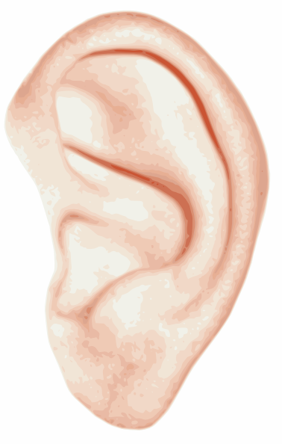
Hear

Slide 98
Memorise

Slide 99
See

Slide 100
1: Be-lie-ve

Slide 101
2: Bu-sin-ess

Slide 102
3: Se-para-te

Slide 103
4: Envi-ron-ment

Slide 104
Hear

Slide 105
5: Govern+ment

Slide 106
6: Feb-RU-ary

Slide 107
7: Happen+ed

Slide 108
8: Sur+prise

Slide 109
9: Interesting

Slide 110
Memorise

Slide 111
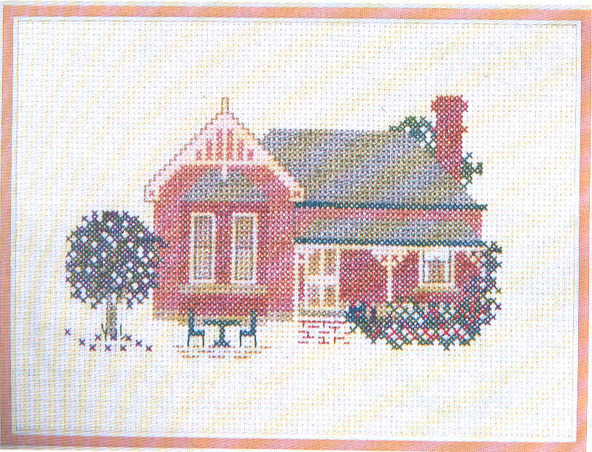
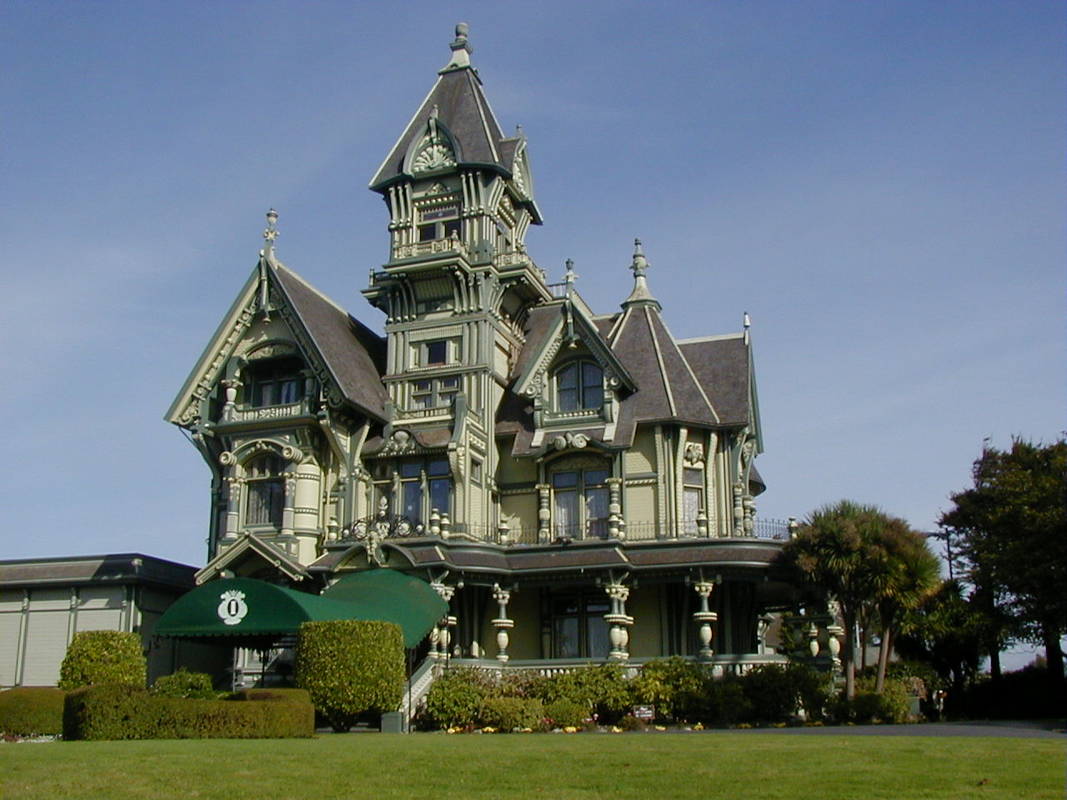
10: Accommodation

Slide 112
11: Skilful

Slide 113
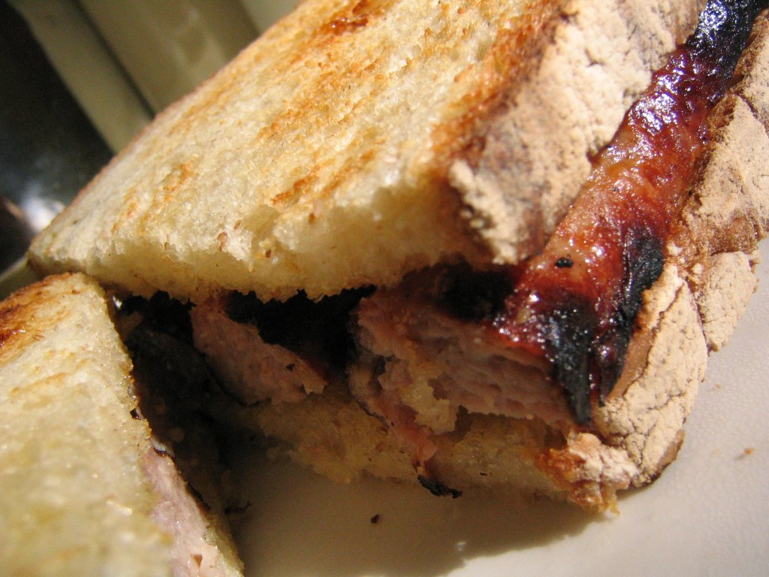
12: Necessary

Slide 114
Spelling is not about intelligence
Test

Slide 115
How to get in training for a C or above

Slide 116
Read and write stuff
Hide your spelling weaknesses
Learn vocabulary (eg “suggest”)
Learn to trick the examiner
Trick your brain

Slide 117
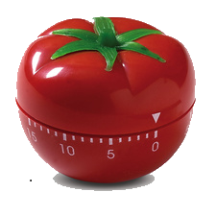
25 mins
+5 mins
Pomodoro Technique

Slide 118
Spelling is not about intelligence

Slide 119
English GCSE: C or higher – guaranteed!
Thursday, March 10, 2011

