Slide 1
Spelling is not about intelligence

Slide 2
Spelling is not about intelligence

Slide 3
1: You’re better at spelling than you think

Slide 4
2: People judge us by appearances

Slide 5
3: A small number of words make a big difference

Slide 6
4: There are 3 easy ways to improve your spelling

Slide 7
5: Stop thinking that spelling is linked to intelligence

Slide 8
Spelling is not about intelligence
Test

Slide 9
TEST

Slide 10
Spelling is not about intelligence
3

Slide 11
See

Slide 12
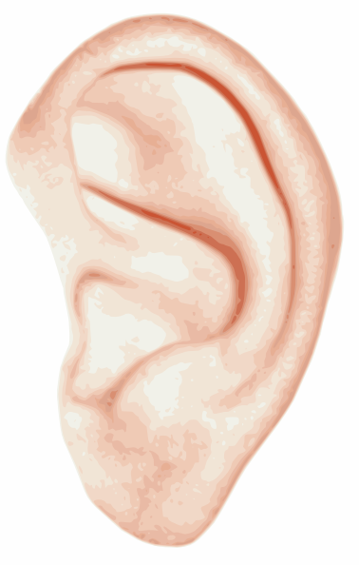
Hear

Slide 13
Memorise

Slide 14
See

Slide 15
1: Be-lie-ve

Slide 16
2: Bu-sin-ess

Slide 17
3: Se-para-te

Slide 18
4: Envi-ron-ment

Slide 19
Hear

Slide 20
5: Govern+ment

Slide 21
6: Feb-RU-ary

Slide 22
7: Happen+ed

Slide 23
8: Sur+prise

Slide 24
9: Interesting

Slide 25
Memorise

Slide 26
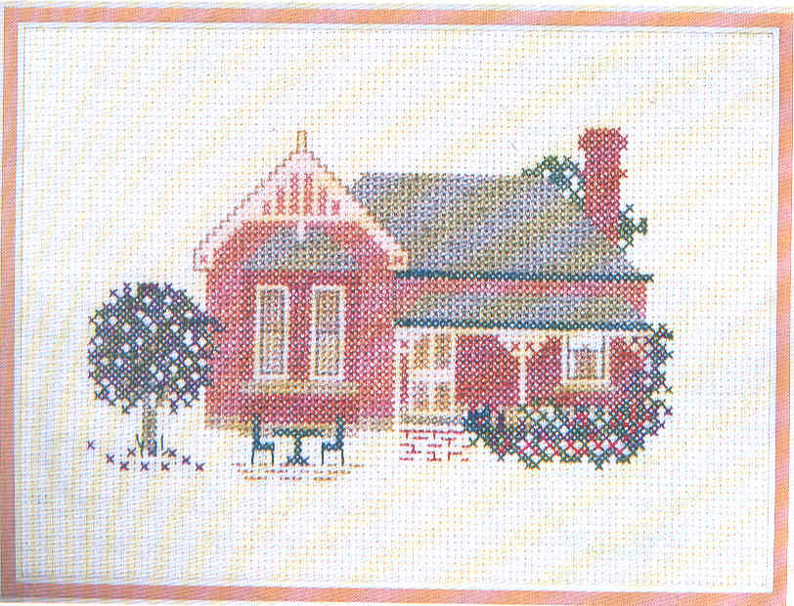
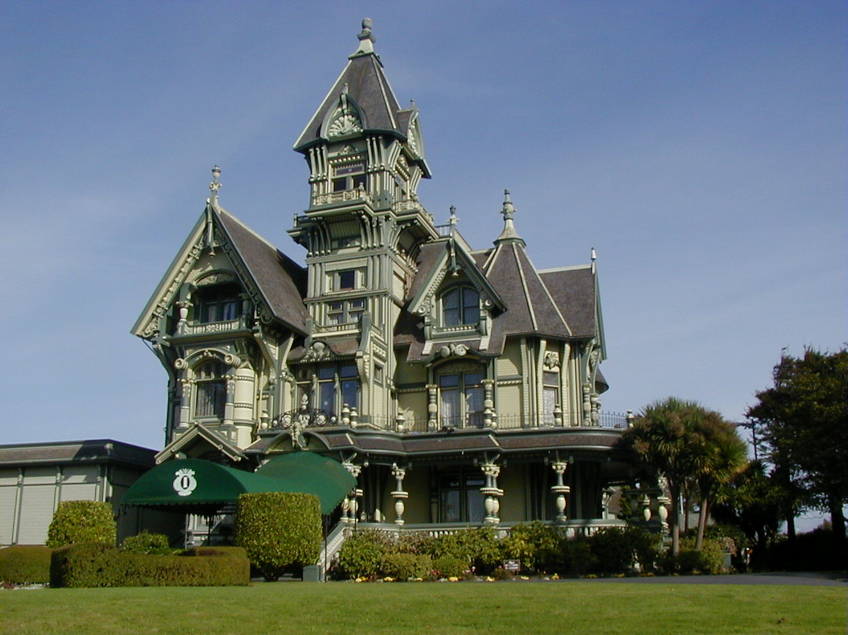
10: Accommodation

Slide 27
11: Skilful

Slide 28
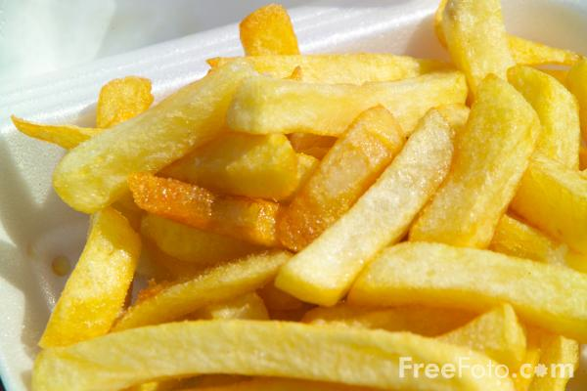
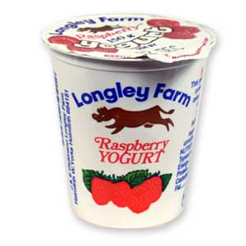
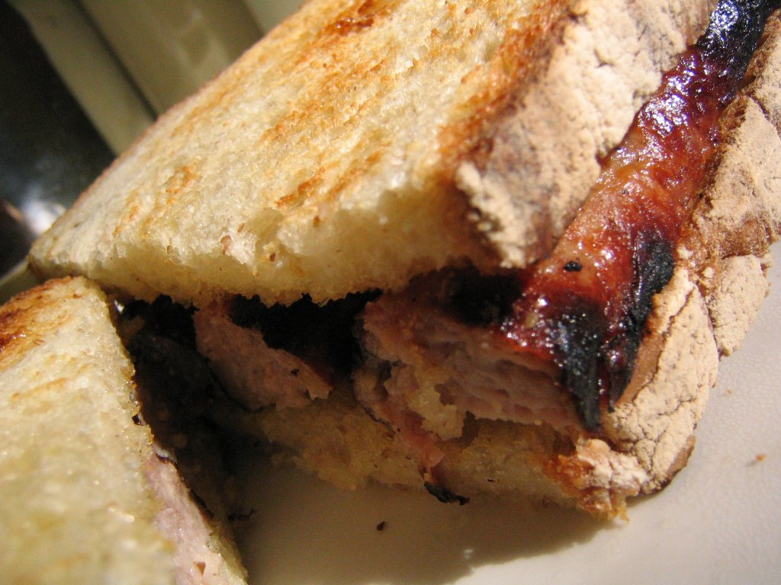
12: Necessary

Slide 29
Spelling is not about intelligence

Slide 30
Spelling is not about intelligence
Test

