Slide 1
English GCSE: Grade C – guaranteed!

Slide 2
Hello.

Slide 3
Getting a C in English is easier than you think

Slide 4
Today

Slide 5
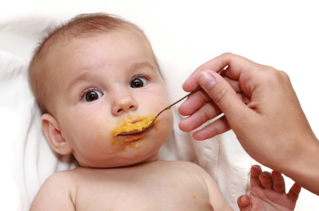
x

Slide 6
What

Slide 7
How

Slide 8
2

Slide 9
1 – Listen
2 - Practise

Slide 10
Visualise what success will feel like

Slide 12
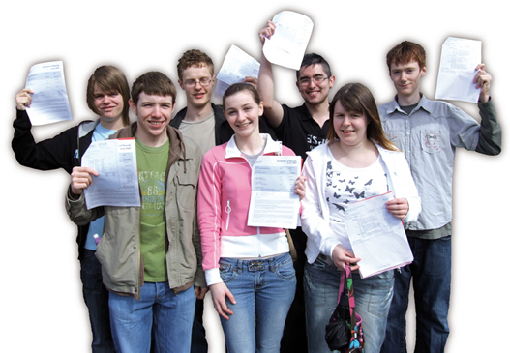

Slide 14
Me

Slide 15
What

Slide 16
English -v-
English Literature

Slide 17
PAPER 1

Slide 18
1:
Reading non-fiction:
understand / presentation / language
Writing to argue / persuade / advise

Slide 19
Write

Slide 20
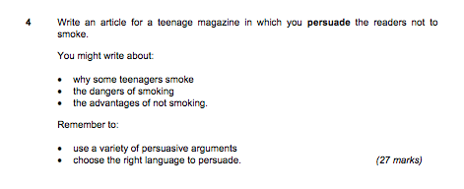

Slide 21
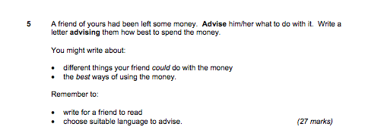

Slide 22
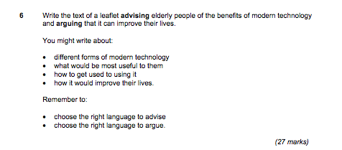

Slide 23
PAPER 2

Slide 24
2:
Reading poetry
Writing to inform / explain / describe

Slide 25
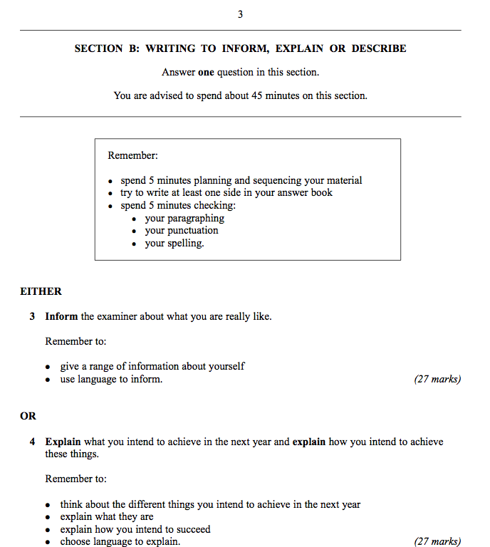

Slide 26
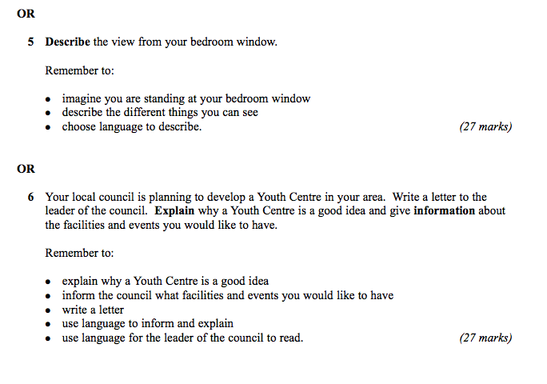

Slide 27
Today:
Write better
Plan better
Spell better

Slide 29
WORD ASSOCIATION

Slide 31
Describe the room you are in

Slide 32
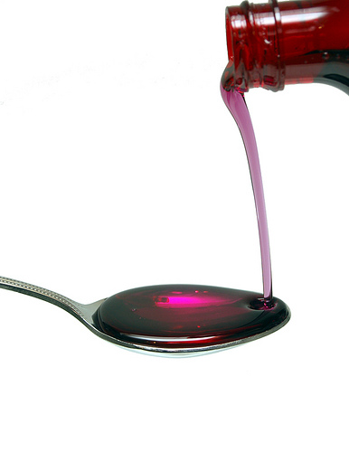

Slide 33
3

Slide 34
1: You find it hard to come up with ideas / to get started / to keep going …
2: You’re not very confident about writing accurately …
3: You’re not sure how to revise for English /you lack concentration …

Slide 35
1: How to write better

Slide 36
Make your sentences shorter: 12 words.
Make some much shorter: 3 – 5 words.
Use “and” less
Join some sentences with “that”, “who”, “which”
Write some 2 part sentences starting with “As …, …”, “Although …, …”, “When …, …”

Slide 37
2: How to plan better

Slide 38
Choose the right question: description and letters are most straightforward
Do a spider diagram of ideas, then number them 5-7 for paragraphing
Use:
Vivid description
Dialogue
Questions
Then & now
For & against

Slide 39
3: How to prepare

Slide 40
Read and write stuff
Hide your spelling weaknesses
Learn vocabulary (eg “suggest”)
Trick the examiner
Trick your brain

Slide 41
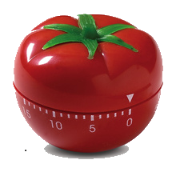
25 mins
+5 mins
Pomodoro Technique

Slide 42
Spelling is not about intelligence

Slide 43
Spelling is not about intelligence

Slide 44
1: You’re better at spelling than you think

Slide 45
2: People judge us by appearances

Slide 46
3: A small number of words make a big difference

Slide 47
4: There are 3 easy ways to improve your spelling

Slide 48
5: Stop thinking that spelling is linked to intelligence

Slide 49
Spelling is not about intelligence
Test

Slide 50
Spelling is not about intelligence
3

Slide 51
See

Slide 52
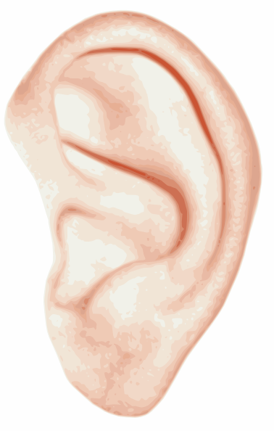
Hear

Slide 53
Memorise

Slide 54
See

Slide 55
1: Be-lie-ve

Slide 56
2: Bu-sin-ess

Slide 57
3: Se-para-te

Slide 58
4: Envi-ron-ment

Slide 59
Hear

Slide 60
5: Govern+ment

Slide 61
6: Feb-RU-ary

Slide 62
7: Happen+ed

Slide 63
8: Sur+prise

Slide 64
9: Interesting

Slide 65
Memorise

Slide 66
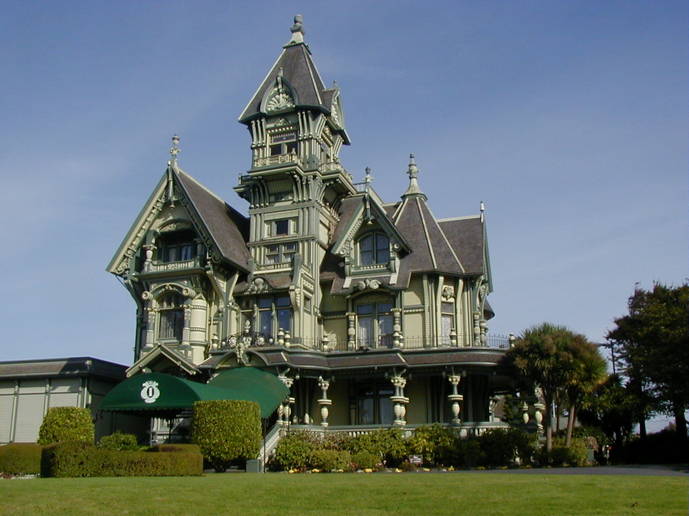
10: Accommodation

Slide 67
11: Skilful

Slide 68
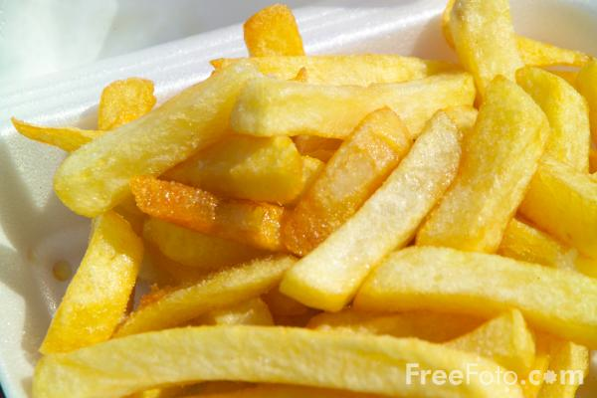
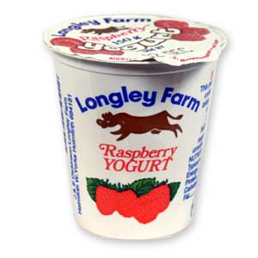
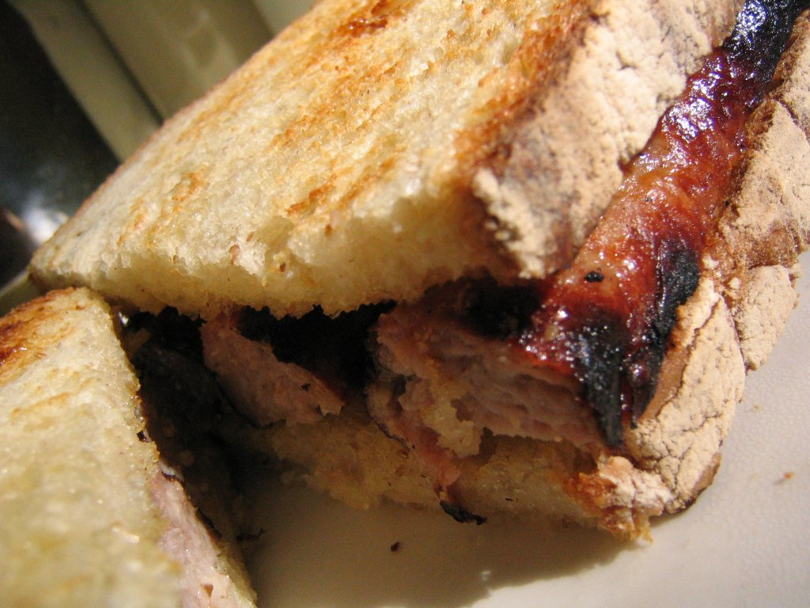
12: Necessary

Slide 69
Spelling is not about intelligence

Slide 70
Spelling is not about intelligence
Test

Slide 71
English GCSE: Grade C – guaranteed!
www.geoffbarton.co.uk

Slide 72
So what have we learned …?

Slide 73
English GCSE: Grade C – guaranteed!
www.geoffbarton.co.uk

Slide 74
GOOD LUCK!
www.geoffbarton.co.uk

