Slide 1
English GCSE: Make it an A or A*

Slide 2
Hello.

Slide 3
Getting a top grade in English is easier than you think

Slide 4
Today

Slide 5
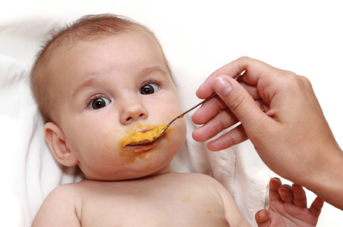
x

Slide 6
What

Slide 7
How

Slide 8
2

Slide 9
1 – Listen
2 - Practise

Slide 10
confidence
self-belief
risk
Plus … read

Slide 11
Visualise what success will feel like

Slide 15
What

Slide 16
D or lower: inaccurate
C: accurate, plus paragraphs
B: accurate plus a bit interesting
A: accurate, interesting, enjoyable
A*: quirky

Slide 17
English -v-
English Literature

Slide 18
PAPER 1

Slide 20
1:
Reading non-fiction:
understand / presentation / language
Writing to argue / persuade / advise

Slide 21
PAPER 2

Slide 22
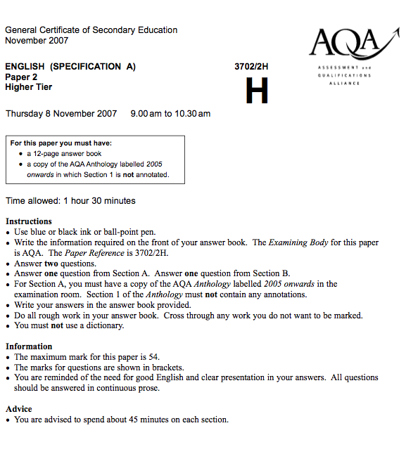

Slide 23
2:
Reading poetry
Writing to inform / explain / describe

Slide 24
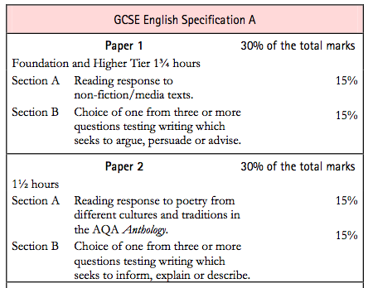

Slide 25
PAPER 1

Slide 27
PAPER 2

Slide 28
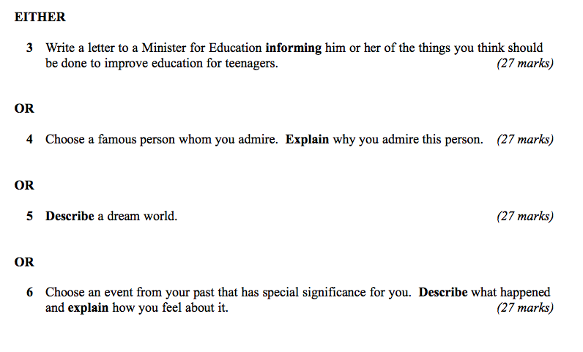

Slide 29
What

Slide 30
How

Slide 32
Describe the room you are in

Slide 34
5
Approaches I wish someone had taught me

Slide 35
1: Sentence Variety

Slide 36
Short and long sentences
Less “and” and “but”
Link with “that”, “who”, “which”
Use 2-part sentences:
As …, …
Although …, …
If …, …
-ing …, …
-ed …, …

Slide 37
2: Vivid vocabulary: Think senses Think metaphors

Slide 38
3: Tone changers: Questions – statements – dialogue – statistics

Slide 39
4: Surprise us (eg pronouns / narrative disjuncture)

Slide 40
5: Advanced punctuation: : ; (,,)

Slide 41
Practise …

Slide 42
Describe a person you admire

Slide 43
Write a letter to your headteacher asking for more PE and sport

Slide 44
How to prepare for your A/A*

Slide 45
Read stuff
Write stuff
Learn vocabulary (eg “suggest”)
Plan
Trick your brain

Slide 46
25 mins
+5 mins
Pomodoro Technique

Slide 47
English GCSE: Make it an A or A*

Slide 48
Spelling Matters

Slide 49
Spelling is not about intelligence
Test

Slide 50
Spelling is not about intelligence
3

Slide 51
See

Slide 52
Hear

Slide 53
Memorise

Slide 54
See

Slide 55
1: Be-lie-ve

Slide 56
2: Bu-sin-ess

Slide 57
3: Se-para-te

Slide 58
4: Envi-ron-ment

Slide 59
Hear

Slide 60
5: Govern+ment

Slide 61
6: Feb-RU-ary

Slide 62
7: Happen+ed

Slide 63
8: Sur+prise

Slide 64
9: Interesting

Slide 65
Memorise

Slide 66
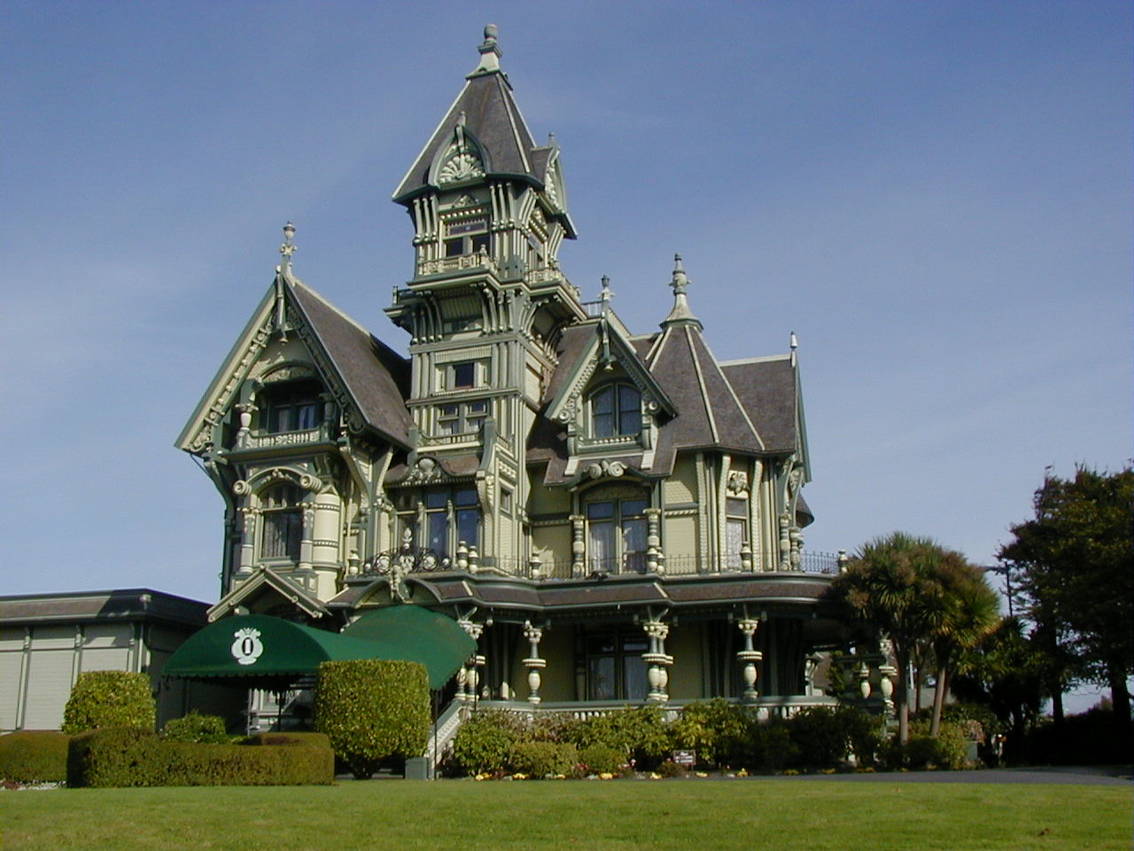
10: Accommodation

Slide 67
11: Skilful

Slide 68
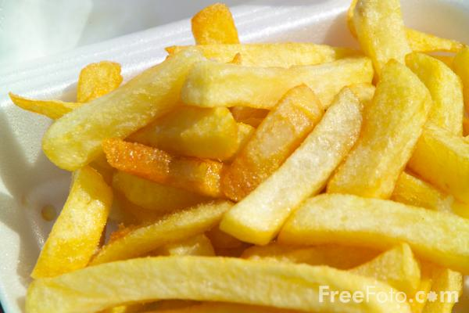
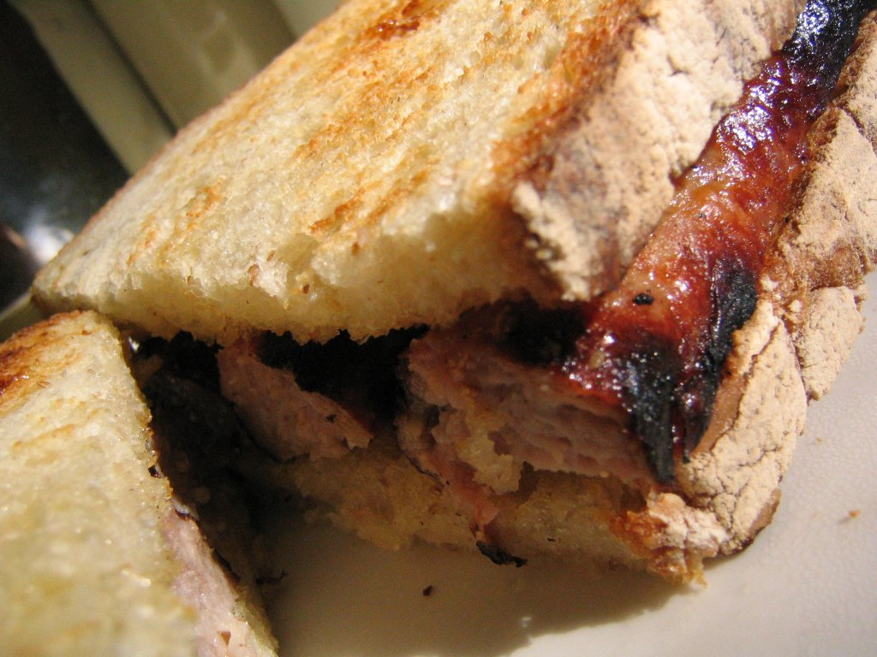
12: Necessary

Slide 69
Spelling is not about intelligence
Test

Slide 70
English GCSE: Make it an A or A*

Slide 71
So what have we learned …?

Slide 72
Good Luck!

Slide 73
www.geoffbarton.co.uk

Slide 74
English GCSE: Make it an A or A*

