Slide 1
Hello, Early Modern English
Goodbye Old & Middle English
A lesson of genius by Mr G Barton

Slide 2
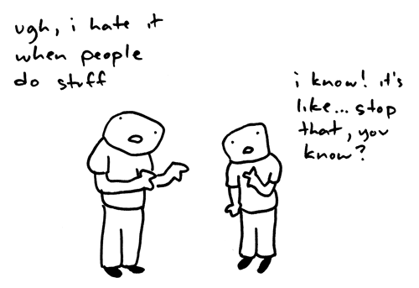
Stuff you should be able to do ….

Slide 3
Goodbye …

Slide 4
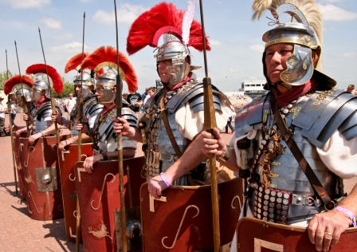

Slide 5
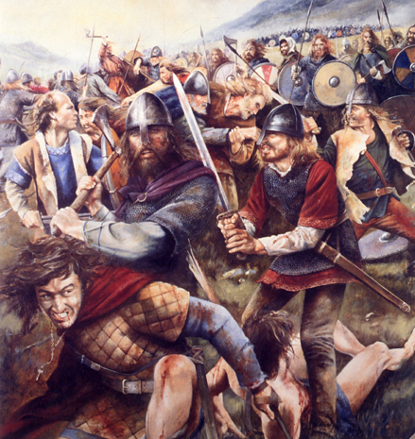

Slide 6
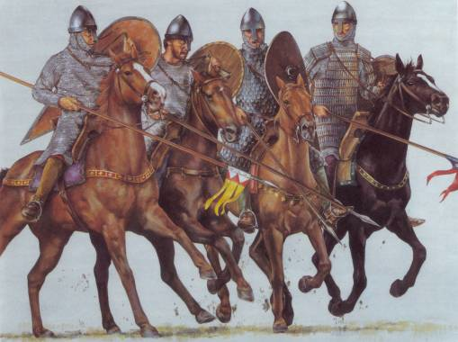

Slide 7
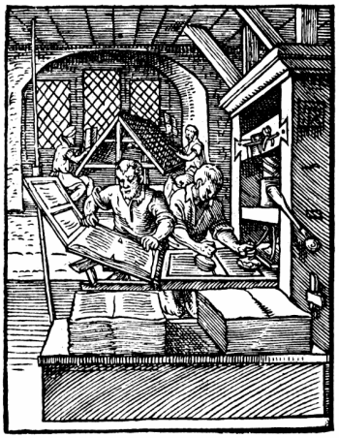

Slide 9
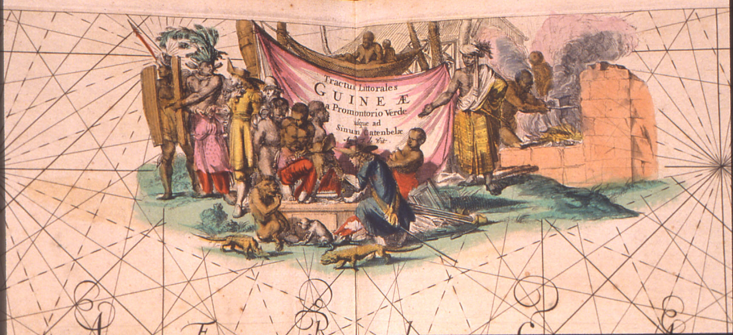

Slide 11
Hello …

Slide 12
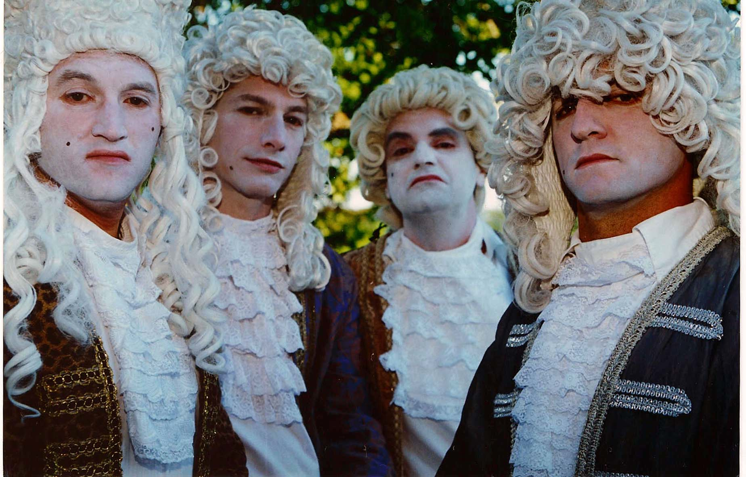

Slide 13
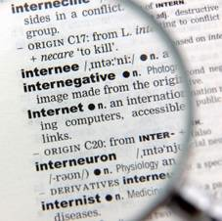

Slide 14
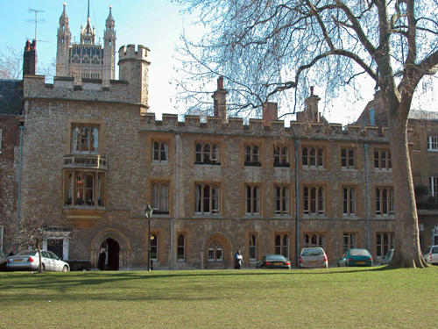

Slide 15
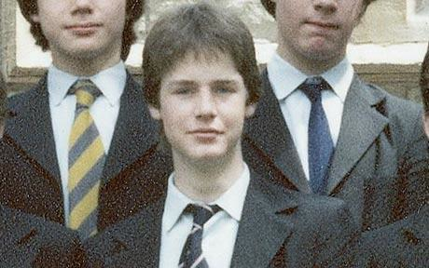

Slide 17
Hello, Early Modern English
Goodbye Old & Middle English
A lesson of genius by Mr G Barton

